Slide 1
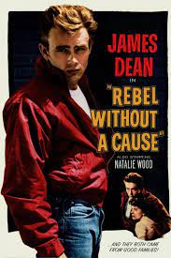
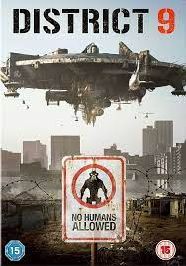
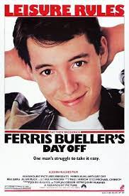
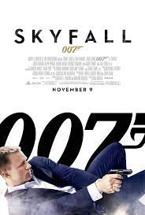
Film language includes:
narrative cinematography sound,
mise-en-scene
and editing.
Areas of study include:
Representation
Aesthetics
Narrative
Genre
Specialist writing and
Screenwriting
GCSE FILM STUDIES – MISS IT, MISS OUT!
Write and film your own scene for Component 3!
What will I study?
Contemporary UK Film, Global English Language Film, Screenplay/Sequence Global non-English film,
US Independent Film
Comparative US Films
and Film Technology.

Slide 2
Content
This is a new GCSE that we are excited to be offering at Cefn Saeson for the first time. We are one of the only local Comprehensive Schools to offer this qualification!
What is Film Studies?
Film Studies is an engaging and exciting subject that gives students an opportunity to develop a critical perspective on film and the role it plays within our society. Students gain an appreciation of film as an art form in terms of its visual storytelling, whilst also exploring how values, attitudes, ideas, and beliefs are communicated in film.
We study films from a broad range of historical and cultural contexts as well as different genres and students develop their critical thinking and analytical skills to write perceptive and thoughtful personal responses to film.
There is also a creative production element, where students will be able to craft their own short film or write a screenplay, then evaluate the process!

Slide 3
Content
Assessment:
70% Exam
30% Coursework
There are three distinct components for GCSE Film Studies:
Component 1 covers the Key Developments in US Film and consists of the close study of a US Film Comparison – namely “Rebel without a Cause” and “Ferris Bueller’s Day Off”; an overview of key Developments in Film and Film Technology; and an Independent Film “Juno”. These three units are completed with a Written Examination of 1 hour 30 minutes with 70 marks awarded, accounting for 35% of the GCSE.
Component 2 looks at Global Film and the presentation of Narrative, Representation and Film Style. As such, we study Narrative in relation to the global, English language film “District 9”; we evaluate Representation in the global, non-English language film, ‘The Wave’ and we analyse Film Style in the contemporary UK Film “Skyfall”. Again, these three units are completed with a Written Examination of 1 hour 30 minutes with 70 marks awarded and accounting for 35% of the GCSE.

Slide 4
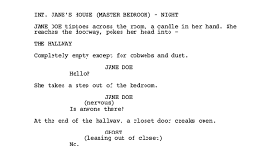
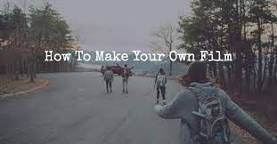
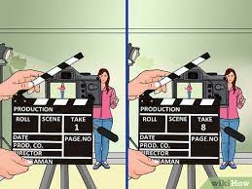
Content
Component 3, accounting for 30% of the GCSE, requires learners to create an individual production from either the Crime, Sci-Fi, Horror, Teenage Film or Action genres. Students may create an opening sequence or an extract from their film showing the introduction of a character lasting 2 minutes 30 seconds. Students can film their extract or produce a screenplay for their extract accompanied by a shooting script detailing camera directions and editing techniques.

Slide 5
Exam
The Assessment for film studies is a mixture of examination and coursework:
70% Exam
30% Coursework
Component 1 is a written examination on Key Developments in US Film
1 hour 30 minutes
35% of qualification
Component 2 is a written examination on Global Film: Narrative, Representation and Film Style
1 hour 30 minutes
35% of qualification
Component 3 is coursework (non-examination
assessment)
Production of a screenplay or film extract
30% of qualification

Slide 6
Staff
Mrs F. Goss is the subject specialist delivering the course.
Having studied for a Masters Degree in Drama and with over 20 years of experience teaching English and Media, key strengths for this amazing subject, you can guarantee that her lessons will be both enjoyable and compelling!

Slide 7
Careers
Jobs where film studies would be useful include:
Advertising art director
Arts administrator
Community arts worker
Concept artist
Event manager
Marketing executive
Public relations officer
Runner, broadcasting/film/video
Special effects technician
Talent agent
VFX artist
Broadcast presenter
Film director
Film/video editor
Location manager
Production designer, theatre/television/film
Programme researcher, broadcasting/film/video
Television camera operator
Television/film/video producer
Television production coordinator

Slide 8
Pupil views
Film is a powerful and influential medium and is central to today’s society and culture.
Here’s what this year’s Film students have to say…
”Film Studies is an interesting way to analyse films.”
“ It can get you a better job than other subjects and it’s fun!”
“ It is interesting for people who like films and tv shows.”
“It is interesting to learn about ..different things in a film and what they symbolise.”

Slide 9
Video

