Slide 1
GCSE
RELIGIOUS
STUDIES

Slide 2
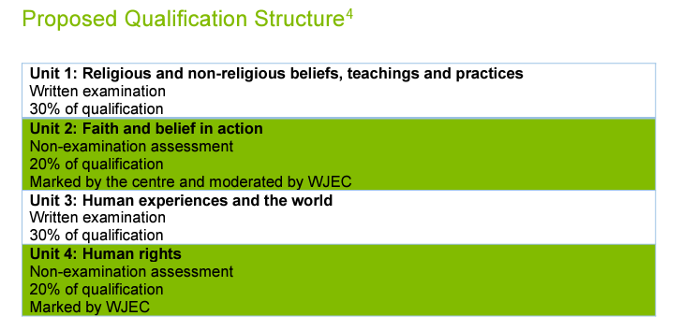
Content
Exam
Staff
Careers
Pupil view
Video
The course is made up of 4 units.
Two will be written exams. Two will be controlled assessments.

Slide 3
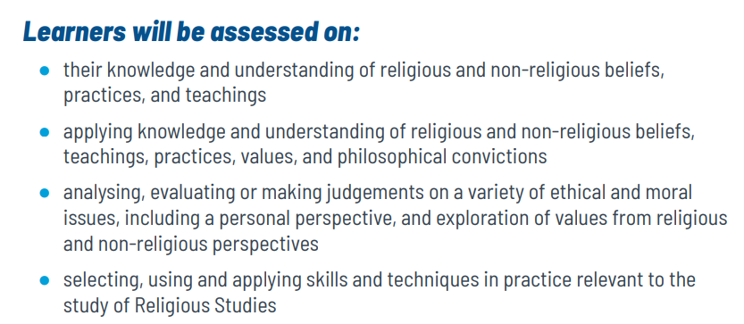
Content
Exam
Staff
Careers
Pupil view
Video

Slide 4
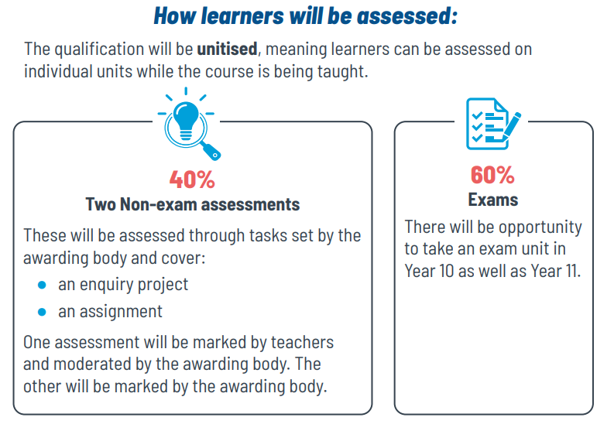
Exam

Slide 5
Staff
Miss Williams is the Head of Department for Religious Studies and Miss Morris is a subject specialist for Religious Studies.
Exam classes will be taught by either Miss Williams or Miss Morris

Slide 6
Careers
How Religious Studies will help you in the future
Aside from the fact that you will have developed a knowledge and understanding of differing beliefs, teachings and practices, Religious Studies also helps you to develop a number of skills including:
*Empathy
*The ability to evaluate
*How do demonstrate your knowledge and understanding
*The ability to construct an argument
(to name a few!)
Future Careers
Essentially, Religious Studies can help you with any career in which you have to have contact with people!
Air Cabin Crew
Chef
Human Resources
Journalist
Law
Medicine (Dr, Nurse, Health Visitor, Physiotherapist, Carer etc)
Police
Social Worker
Teacher
Teaching Assistant

Slide 7
Pupil views
“VIEWS OF CURRENT GCSE STUDENTS”
“Religious Studies gives you an understanding about other religions and about other people opinions”
“Religious Studies is brilliant at GCSE because you learn how to discuss and learn about other cultures. Manu universities and colleges look for this GCSE”
“Religious Studies gives you the opportunity to learn about different views in the world. It allows you to express your opinion and develop your debating skills. It is extremely interesting and gives you an open mind”
“Religious Studies helps you understand other people. It is an important qualification to have to enable you to succeed in life”
“Religious Studies helps you understand what other people believe and how other people live”

Slide 8
Video
https://youtu.be/3p5psxKn1CY

