Slide 1
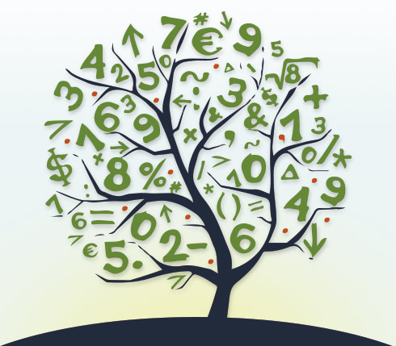
GCSE
Mathematics and Numeracy (Double Award)

Slide 2
Content
Exam
Staff
Careers
Pupil view
Video
This will be a unitised qualification which means that pupils will sit examinations during the course and not all at the end of the course.
Aspects of number, algebra, geometry and measures, statistics and probability will be explored in every unit of the qualification, supporting the statement that ‘the different areas of mathematics are highly interconnected and dependent on one another’ included in the specific considerations for this Area.
The qualification will also support key links with other Areas of the Curriculum for Wales, including developing learners’ financial literacy in support of learner wellbeing.
Examinations allowing the use of a calculator will make up 70% of assessment, and a non- calculator paper will make up the remaining 30%.
Unit 1: Financial Mathematics and Other Applications of Numeracy 30% of qualification
Unit 2: Non-calculator Mathematics 30% of qualification
Unit 3: Calculator Mathematics 40% of qualification

Slide 3
Content
Exam
Staff
Careers
Pupil view
Video
GCSE Mathematics and Numeracy (Double Award) is based on the five interdependent proficiencies that make up the Curriculum for Wales’ principles of progression for the Mathematics and Numeracy Area.
The qualification will:
provide opportunities for learners to develop a conceptual understanding of mathematical concepts and ideas
provide opportunities for learners to develop an understanding of a wide range of mathematical language and to demonstrate this communication using symbols
allow learners to demonstrate the use and application of mathematical and numerical skills fluently and accurately
support leaners to develop and apply logical reasoning when justifying and proving relationships between concepts
provide opportunities for learners to independently demonstrate strategic competence when using mathematical ideas to solve problems.
The content of GCSE Mathematics and Numeracy (Double Award) qualification will be based on the following mathematical and numerical concepts that make up the Curriculum for Wales’ statements of what matters for the Mathematics and Numeracy Area:
number
algebra
geometry and measures
statistics and probability

Slide 4
Content
Exam
Staff
Careers
Pupil view
Video
In Mathematics pupils will develop the following:
Recall and use their knowledge of the prescribed content:
demonstrate conceptual understanding through remembering and using mathematical facts, relationships, concepts and techniques
follow direct instructions to solve problems involving routine procedures fluently
Select and apply mathematical methods:
select and use the mathematics and resources needed to solve a problem fluently
select and apply mathematical methods to solve nonstandard or unstructured, multi-step problems fluently
make decisions when tackling a given task, for example, choosing how to display given information
communicate mathematically, using a wide range of mathematical language, notation and symbols to explain reasoning and to express mathematical ideas unambiguously
Demonstrate strategic competence by making connections between different aspects of mathematics and using mathematical skills in unfamiliar contexts:
demonstrate strategic competence by interpreting and analysing problems and generating strategies to solve them
devise strategies to solve non-routine or unfamiliar problems, breaking them into smaller, more manageable tasks where necessary
construct arguments and proofs using logical reasoning and deduction
interpret findings or solutions in the context of the original problem
use inferences and deductions made from mathematical information to draw conclusions

Slide 5
Exam
Unit 1: Financial Mathematics and Other Applications of Numeracy
The purpose of this unit is to:
introduce and develop learners’ understanding of topics and concepts relating to finance and to support learners’ confidence in relation to financial wellbeing
allow learners to use their knowledge and apply mathematical methods to personal, real-world contexts, including those related to money and the workplace.
The assessment will focus on a range of topics from across all four statements of what matters in Mathematics and Numeracy, including some aspects of statistics and algebra, and the numeracy aspects of measures and number.
A calculator will be allowed in this examination.
The examination will include a mix of questions that are in context and questions without context.
The duration of the examination is likely to be 1 hour 45 minutes at higher tier and 1 hour 30 minutes at foundation tier.

Slide 6
Exam
Unit 2: Non-calculator Mathematics
The purpose of this unit is to:
explore mathematical topics and concepts that don’t require the use of a calculator
The assessment will focus on a range of topics from across all four statements of what matters in Mathematics and Numeracy, including non- calculator number work, algebra, geometry and probability.
A calculator will not be allowed in this examination.
The examination will include a mix of questions that are in context and questions without context.
The duration of the examination is likely to be 1 hour 45 minutes at higher tier and 1 hour 30 minutes at foundation tier.

Slide 7
Exam
Unit 3: Calculator Mathematics
The purpose of this unit is to:
explore topics and concepts that are most appropriately assessed with a calculator.
The assessment will focus on a range of topics from across all four statements of what matters in Mathematics and Numeracy, including elements of number, geometry, measures and algebra that require a calculator, and statistics.
A calculator will be allowed in this unit.
The examination will include a mix of questions that are in context and questions without context.
The duration of the examination is likely to be 2 hours at higher tier and 1 hour 45 minutes at foundation tier. This reflects the higher weighting of this unit.

Slide 8
Staff
The Mathematics department staff.
Mr G Pritlove Mr J Myles Ms. H Hodge Mr D Battell Ms C Webborn Ms J Roberts

Slide 9
Careers
How Mathematics will help you in the future
Aside from the fact that you will have developed a knowledge and understanding of mathematical principles and problem solving, Mathematics also helps you to develop a number of skills including:
*Reasoning
*The ability to evaluate
*How do demonstrate your knowledge and understanding
*The ability to break down complex problems into a sequence of smaller, solvable steps.
(to name a few!)
Future Careers
Graduates of Mathematics tend to be sought after by many industries!
Actuary
Accountant
Data Analyst
Investment Analyst
Risk Assessor
Software Engineer
Teacher
Police
Statistician
Investment Analyst
Quantity Surveyor

Slide 10
Pupil views
VIEWS OF STUDENTS
“My teacher makes me work hard but always gives me help if I’m struggling”
“I used to really hate maths but now I quite enjoy it. I actually think I can pass my GCSEs now”
“I didn’t think that the jump from primary school was as hard as I was expecting”
“I have already passed my Maths GCSE because I sat it early. I have sat my Numeracy GCSE and I’m waiting for my result. We’re now doing Finance.”
“You go over things that you know and then add in extra stuff”

Slide 11
Video

