Slide 1
History GCSE

Slide 2
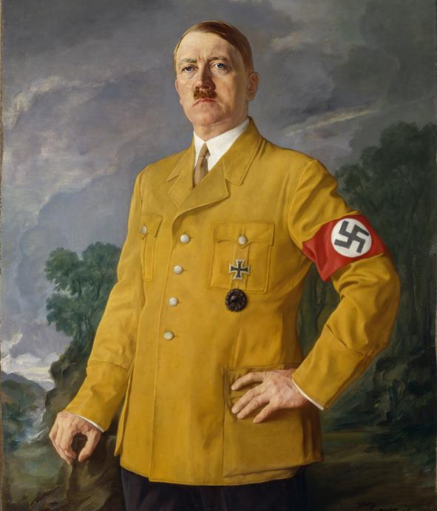
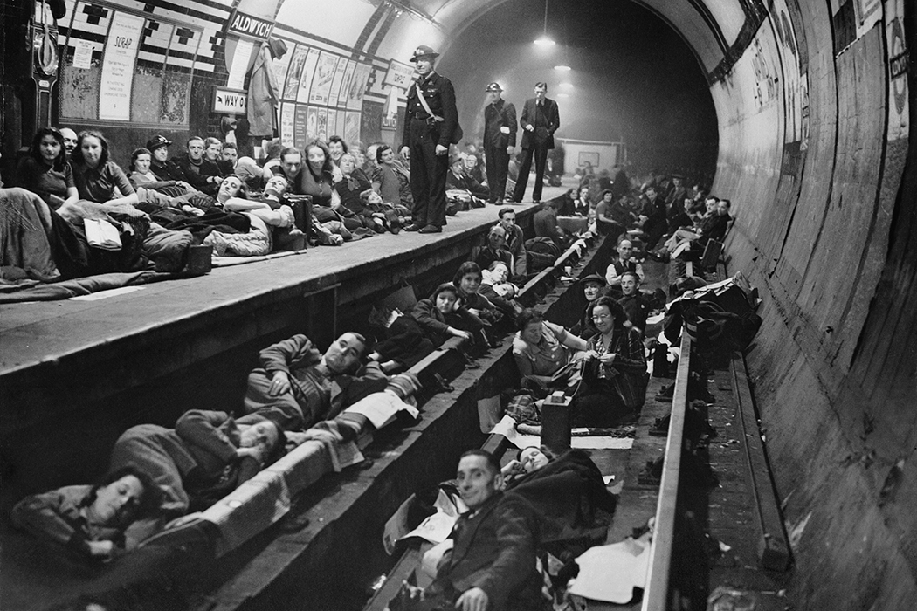
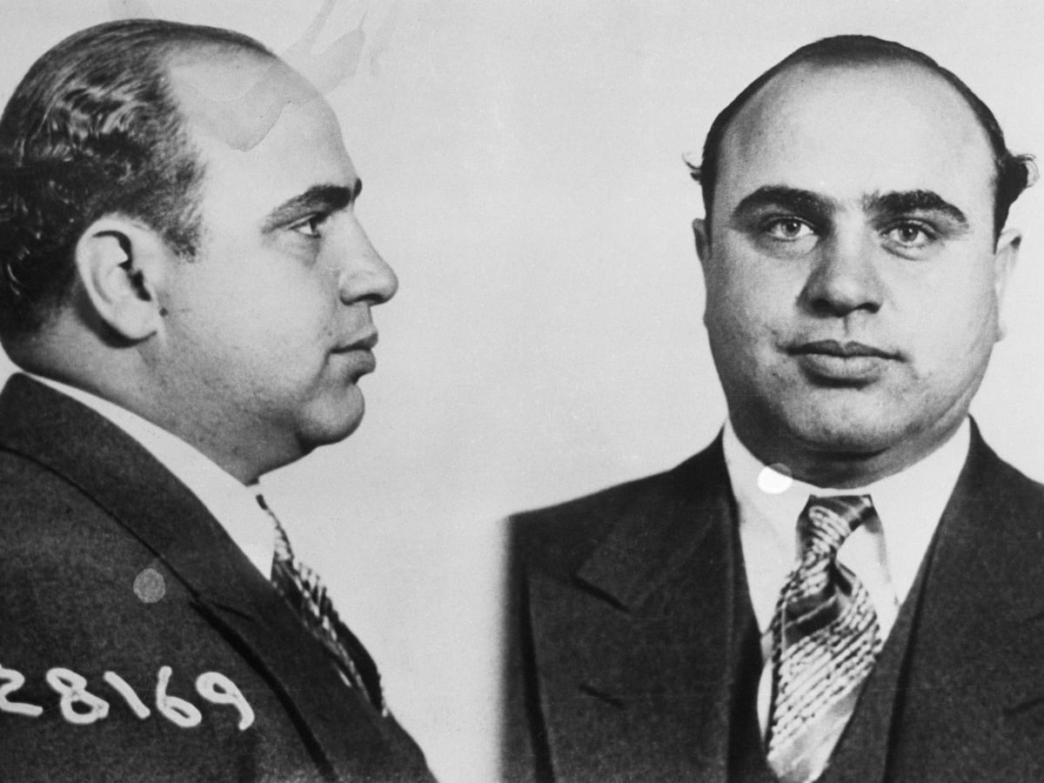
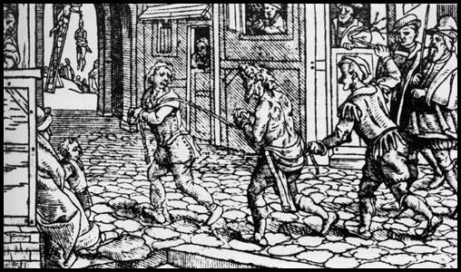

Slide 3
Content
Exam
Staff
Careers
Pupil view
Video
Do you enjoy reading about the century’s major events that have shaped the way we live? Do you enjoy debates and discussions about important issues? If so, then History is the subject for you! For the first three years at Cefn Saeson you have been studying a wide range of topics from the Middle Ages to the Twentieth Century. Now at Key stage 4, you will have the opportunity to put all the skills you have learned to a more detailed study of History.
The History Department has consistently achieved excellent results in recent years (38% A*-A grades - joint highest in the Authority! History Results NPT 2023) and we expect a total commitment to the subject and for all students to demonstrate the ability to work hard. We place a great emphasis on developing study skills, on examination technique and in developing the ability to communicate fluently in both speaking and writing.

Slide 4
Content
Exam
Staff
Careers
Pupil view
Video
See the next slide for some of the exciting topics we cover…

Slide 5
Content
Exam
Staff
Careers
Pupil view
Video
Sorry! The WJEC are yet to publish the content for the new GCSE, this page will be updated as soon as possible!

Slide 6
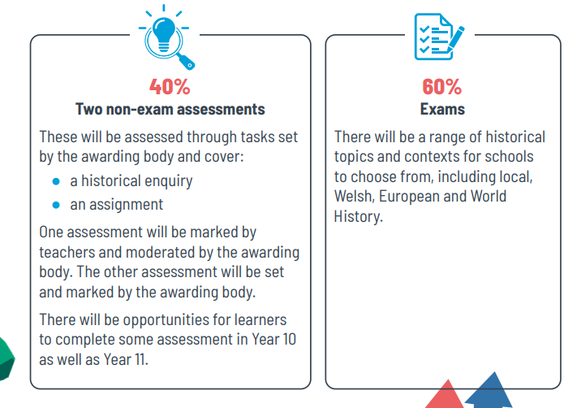
Exam

Slide 7
Staff
All GCSE classes are taught by subject specialists;
Mrs L. Williams, Head of History
Miss S. Roberts, Teacher of History and School Council Lead

Slide 8
Careers
History is unique in its ability to train people to think, analyse, collect, sort and produce information. It is an exciting and stimulating subject which permits many combinations at 'A' level and further education.
It is an excellent discipline if you are thinking of a career in;
Law
Criminology
Police
Journalism
Television or film
Research
Government – local government or Prime Minister!
Education
Tourism

Slide 9
Pupil views
Please copy and paste the link below into a web browser to watch our Pupil Views video
https://web.microsoftstream.com/video/c44647c2-bf24-41b4-bd83-09999c1c00f3
https://web.microsoftstream.com/video/c44647c2-bf24-41b4-bd83-09999c1c00f3

