Slide 1
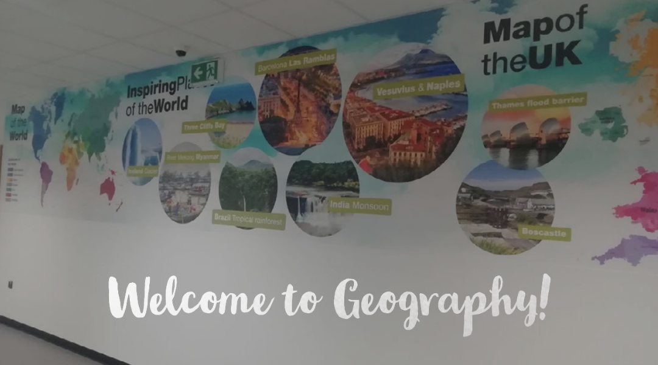
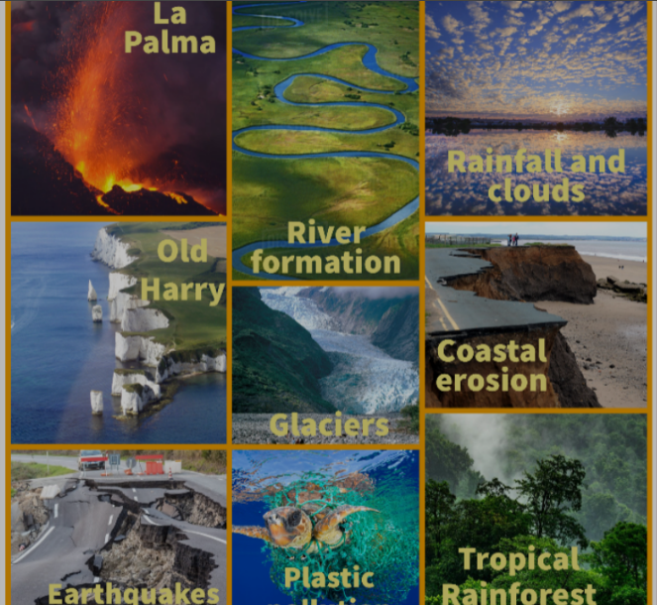
GCSE
GEOGRAPHY
Interested in finding out about the world we live in? Want to know how it works?
Then Geography is for you!
The planet constantly changes - new countries are made, political situations change, hurricanes affect coastlines and flooding happens & we have the opportunity to study the most up to date information.

Slide 2
Content
Exam
Staff
Careers
Pupil view
Video
Proposed Qualification Structure is:
Unit 1: Core Concepts in Geography
Unit 2: Developing Fieldwork Skills Non-examination assessment
Unit 3: Contemporary Issues in Geography
Unit 4: Potential Sustainable Solutions Non-examination assessment – decision making exercise

Slide 3
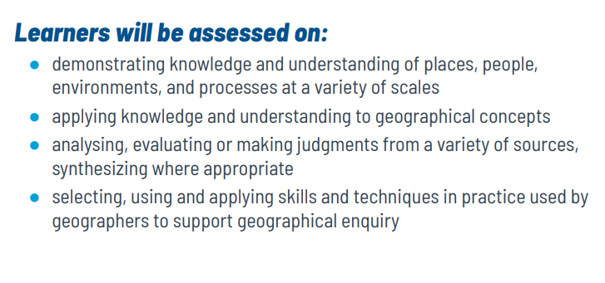
Content
Exam
Staff
Careers
Pupil view
Video

Slide 4
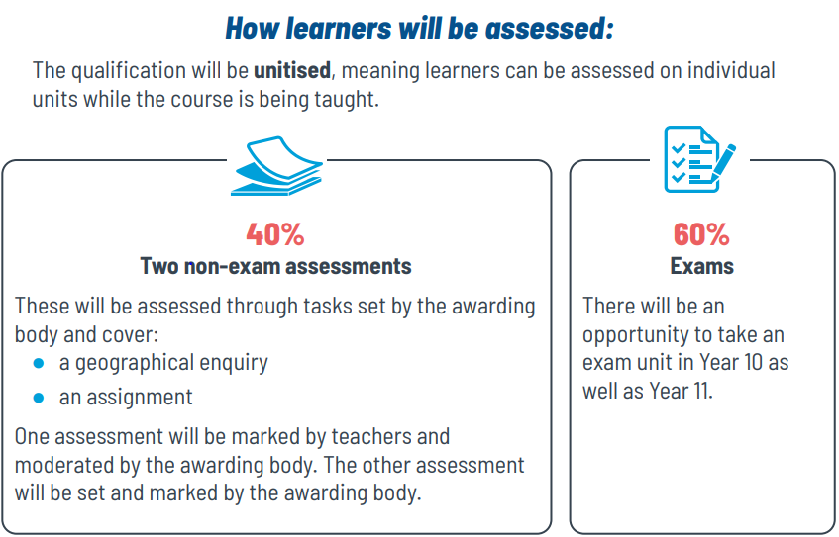
Exam

Slide 5
Staff
All classes taught by experienced subject specialists
Head of Geography and Tourism: Mrs K. Penquet
Teacher of Geography and Tourism:
Miss H.Matthews

Slide 6
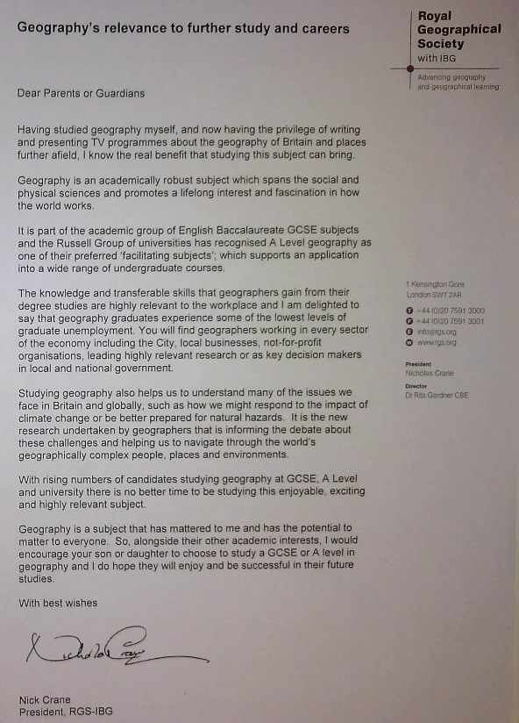
Careers
Geography will help you develop communication & teamwork skills & employers love the mix of technical & social skills which they see as very transferable, i.e. useful for a whole range of jobs. Geography is great for any kind of career involving the environment, planning, interpreting data, problem-solving or working with people.
Popular careers include:
town or transport planning, surveying, conservation, sustainability, environmental planning, tourism, architecture, weather forecasting, journalism or teaching.
The army, police, government, finance, research organisations, law & business worlds also love the practical research skills that geographers develop.

Slide 7
Pupil views
Views of current GCSE students
“Geography is a brilliant facilitating subject to help you get into university”
“Geography has helped me with my other subjects like Maths and Science”
“I have learnt many skills and ways to revise my work”
“Geography has helped me form valid opinions and present my work confidently to the class”
“Geography has helped me understand the real world around me and how I fit into it”

Slide 8
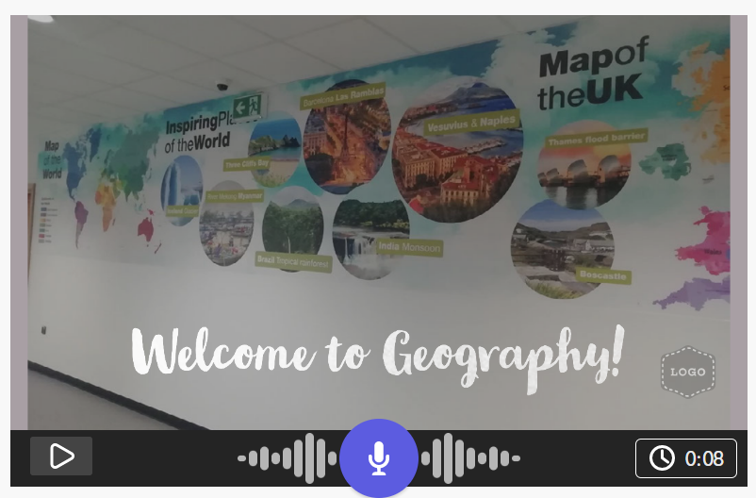
Video
https://spark.adobe.com/video/Y05vqo97d8lvF

