Slide 1
English

Slide 2
Content
Exam
Staff
Careers
Pupil view
Video
GCSE English Language and Literature
This course allows you to investigate, examine and create a wide range of texts for different audiences and purposes.
You will learn to communicate effectively, using speaking and listening, reading and writing skills.

Slide 3
Content
Exam
Staff
Careers
Pupil view
Video
Entry Level in English
Some learners will study for an Entry Level certificate in English, sometimes as a ‘stepping stone’ to GCSE.
This course, like GCSE English Language, helps you to develop oracy, reading and writing skills. But it will focus on those communication skills you will need in everyday life, the world of work and in other curriculum areas.

Slide 4
Exam
English Language​ and Literature
The course is divided into three units: One of these are assessed as external written exams; and two takes the form of controlled assessment (Speaking and Listening and Reading and Writing).
​

Slide 5
Exam
Entry Level in English
Read
Write
Communicate
Listen
Speak
Entry Level
The course is divided into three components:​
Component 1 Written exam – assessing understanding of non-literary reading, and the production of functional writing. (25%)
Component 2 Topic tests – assessing a response to literature, editing and sequencing, narrative writing and proofreading. (60%)
Component 3 Practical assessment – communicating a point of view, and using oracy for the world of work. (15%)

Slide 6
Staff
Mr C. Morgan

Slide 7
Staff
Mrs C. Hutin

Slide 8
Careers

Slide 9
Careers
English allows you to develop essential analysis, creativity and communication skills.
It opens the door to a vast range of career options.
Love the Arts? There are lots of opportunities in media, broadcasting, publishing and arts management.
Enjoy a good debate? You can use your rhetorical skills in the fields of law, politics, governmental and business roles.
In fact, what career wouldn’t value the range of skills English has to offer?
Librarian
Actor
Digital marketer
Researcher
Counsellor
Speech and Language therapist
Vlogger
Barrister/Solicitor
Copy editor
Teacher
Copywriter
Press officer
Journalist
Marketing executive
Games developer
Screen-writer
Reporter
Author
Arts administrator
Producer

Slide 10
Pupil views
The English Department really do want all of their students to succeed.
Studying English has helped me find my voice.
English lessons give me skills I plan to use for the rest of my life.
English is challenging – but it’s fun to be challenged.
I am learning to communicate confidently with others.
There’s a lot more to it than just sitting around talking about old books.

Slide 11
Other views

Slide 12
Video
Reading is everything...
Here, a group of Year 11 pupils discuss the importance of libraries, and demonstrate the GCSE English Language skills of 'interacting and responding' (assessed on the 'group discussion' NEA).
Speaking and listening forms 20% of the English Language GCSE.
Watch an example of a GCSE individual researched presentation in action.
Notes:
Videos: Please view the videos by logging in to HWB and accessing the browser version of this PowerPoint presentation.

Slide 13
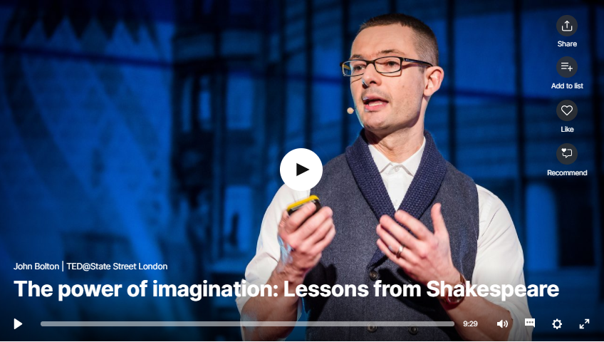
Video
Shakespeare. An essential area of study as part of the English Literature course.
But is Shakespeare still relevant to our 21st century learners?
In this TED talk, John Bolton argues the case for Shakespeare's place in the modern world.
A life in books.
Cefn Saeson's Dr Mills walks us through some of the books that have been an essential part of her learning journey and that have inspired a lifelong love of reading.
John Bolton: The power of imagination: Lessons from Shakespeare | TED Talk

