Slide 1
GCSE
Welsh Second
Language

Slide 2
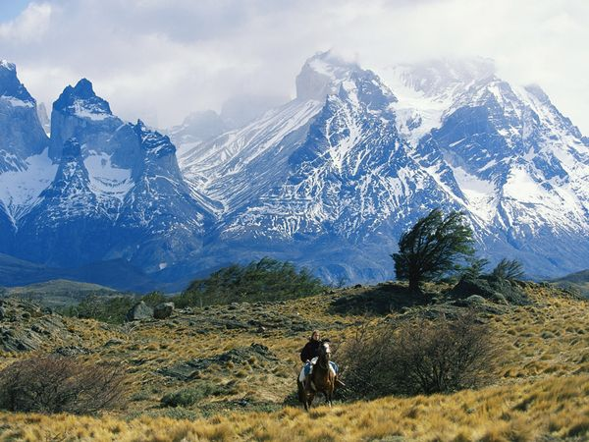
Content
Exam
Staff
Careers
Pupil view
Video
Pwyntiau Pwysig/ Important points to remember:
4 uned (4 units)
Pob uned = 25% (Every unit = 25%)
120 Guided teaching hours needed to complete the course)
Gradd A* > G (A* > G grades) – No tiers
THEMA 1 Cyflogaeth (Employment) |  | THEMA 2 Ieuenctid (Youth) |  | THEMA 3 Cymru a’r Byd (Wales & the World)

Slide 3
Exam
UNIT 1 | UNIT 2 | UNIT 3 | UNIT 4
25% | 25% | 25% | 25%
Gwrando 15% (Listening 15%) Llafar 10% (Oral 10%) | Llafar 20% (Oral 20%) Gwrando 5% (Listening 5%) | Darllen 15% (Reading 15%) Ysgrifennu 10% (Writing 10%) | Ysgrifennu 15% (Writing 15%) Darllen 10% (Reading 10%)
Bl 10 neu 11 (Yr 10 or 11) | Bl 10 neu 11 (Yr 10 or 11) | Arholiad Bl 11 (Yr 11Exam) | Arholiad Bl 11 (Yr 11 Exam)
SPEAKING | 30%
LISTENING | 20%
READING | 25%
YSGRIFENNU | 25%

Slide 4
Staff
Head of Welsh Department and whole school bilingualism:
Ms. Nia Meredith
Teacher of Welsh: Miss. Katie Pickin
We are also fortunate that we have a 1st language Welsh speaker as a cover superviser that when any cover is required will always cover the Welsh Department: Miss Awen Davies-Jones

Slide 5
Careers
Jobs advertised in Wales often ask for Welsh as essential or desirable. If you have Welsh language skills and the other candidates trying for a job don't then you're already one step ahead. All public sector organisations in Wales have to provide Welsh language services so this makes Welsh-speaking employees an asset to companies.
Teacher
Translator
Tourist information Centre Assistant
Media in Wales
Health and care services or Police
Catering
Nursing
Teaching assistant

Slide 6
Pupil views
Pupil views
As we live in Wales it makes sense to be able to speak the language of the country.
More and more people are learning Welsh every month. The government target is for 1 million Welsh speakers by 2050
Welsh is the language of Wales. Speaking Welsh WILL help in the future, especially with job opportunities in Wales.

Slide 7
Resources
‘Dim gobaith caneri’
Gwasg Carreg Gwalch / www.carreg-gwalch.com
Gweithlen cylchgrawn iaw!
Medi a Hydref 2016 / www.urdd.org
Dan y Ditectif Treigladau
Gwasg ‘Dref Wen’ / www.drefwen.com
Seren Iaith 1 a 2
Gwasg @ebol / www.atebol.com
Can Canllaw 1 a 2
Canolfan Peniarth / www.canolfanpeniarth.org
Here are websites you can
use to access resources related
to the course:
Golwg ar Iaith (Non ap Emlyn)
CAA Prifysgol Aberystwyth / caa@aber.ac.uk
Chwiliadur Iaith (Non ap Emlyn)
CAA Prifysgol Aberystwyth / caa@aber.ac.uk
https://www.youtube.com/watch?v=1LdJR_98tQA

