Slide 1
Cefn Saeson
Year 8 Options
Year 8 Options

Slide 2
What to consider when choosing options
Keep your options open and remember you will have the chance to select further subjects at the 16-19 stage
Look at www.careerswales.com
Use the support available to you to help make your choices
Teachers / tutors
Careers adviser – Mrs O’Leary
Parents

Slide 3
What to consider when choosing options
Choose subjects because:
You like it or find it interesting
You think you will do well
You’re good at it
You can develop new skills
It will combine well with other subjects
Your teachers think it is suitable for you
It’s useful for your future career

Slide 4
What to consider when choosing options
Do not choose subjects because:
Your friends are doing it
Your parents think it is a good idea, but you don’t
You think it will be easy
You can’t think of anything else to choose
You like the teacher who teaches it
It sounds good
You think you should do it- even though you haven’t found out about it

Slide 5
Level of Qualifications
Entry Level – 1 2 & 3 (3 being the most difficult)
Level 1 - GCSE Grades D – G, Award, Certificate and Diploma
Level 2 - GCSE Grades A* - C, L2 Award, Certificate, Diploma and Distinction and D*

Slide 6
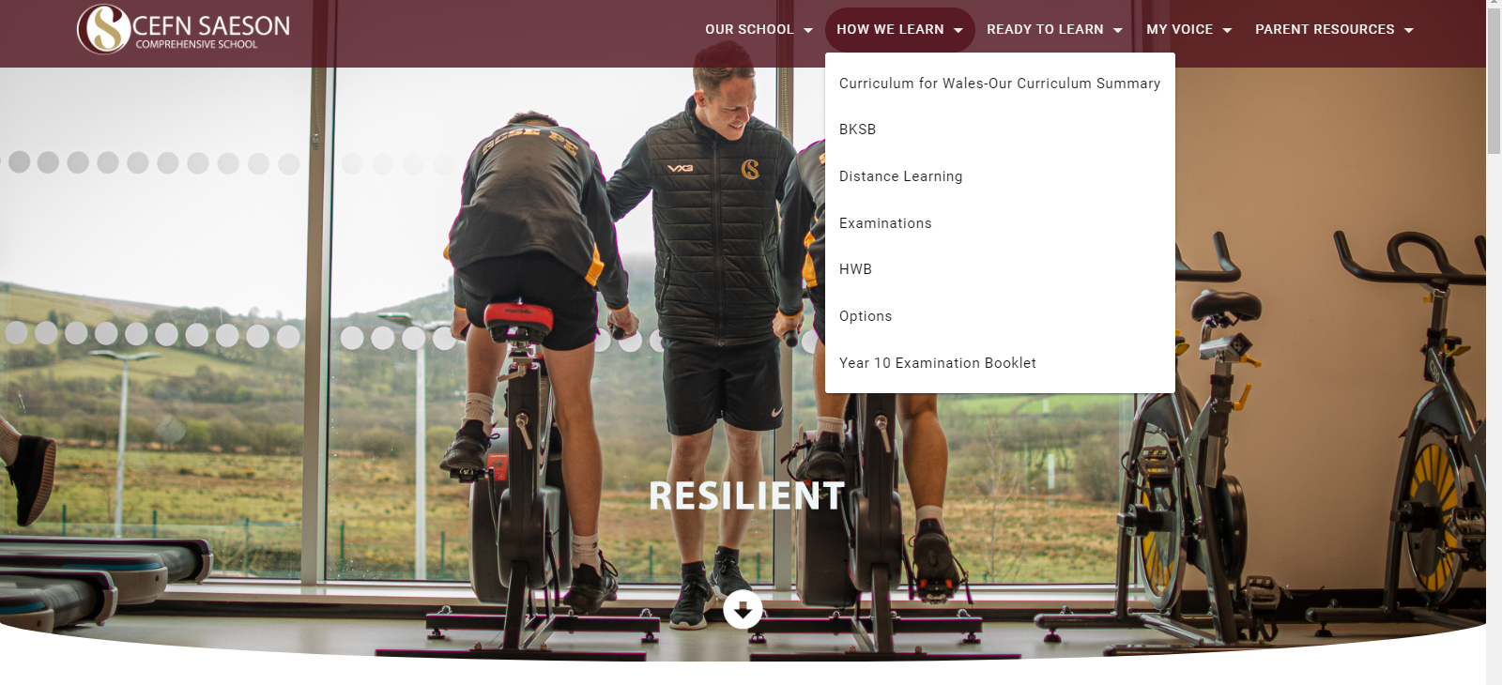
The process of choosing options
All the subjects you can choose are now on the school website.

Slide 7
Core Subjects
The following subject are compulsory and will be delivered to all pupils throughout Year 9, 10 & 11
Mathematics & Numeracy
English (Including English Literature for most pupils)
Double Science
Welsh Studies
RE
Physical Education
Skills Challenge Certificate

Slide 8
The process of choosing options
Take some time to look at the options online, discuss them at home and speak to the subject teachers.
You will all be interviewed by SLT or pastoral staff over the next two weeks, where you will discuss your options and will choose
5 choices - 1 from each column
5 reserve choices – 1 from each column

Slide 9
