Slide 1
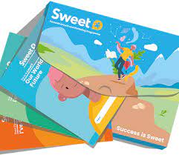
SWEET
BTEC in Personal Growth and Wellbeing Level 1

Slide 2
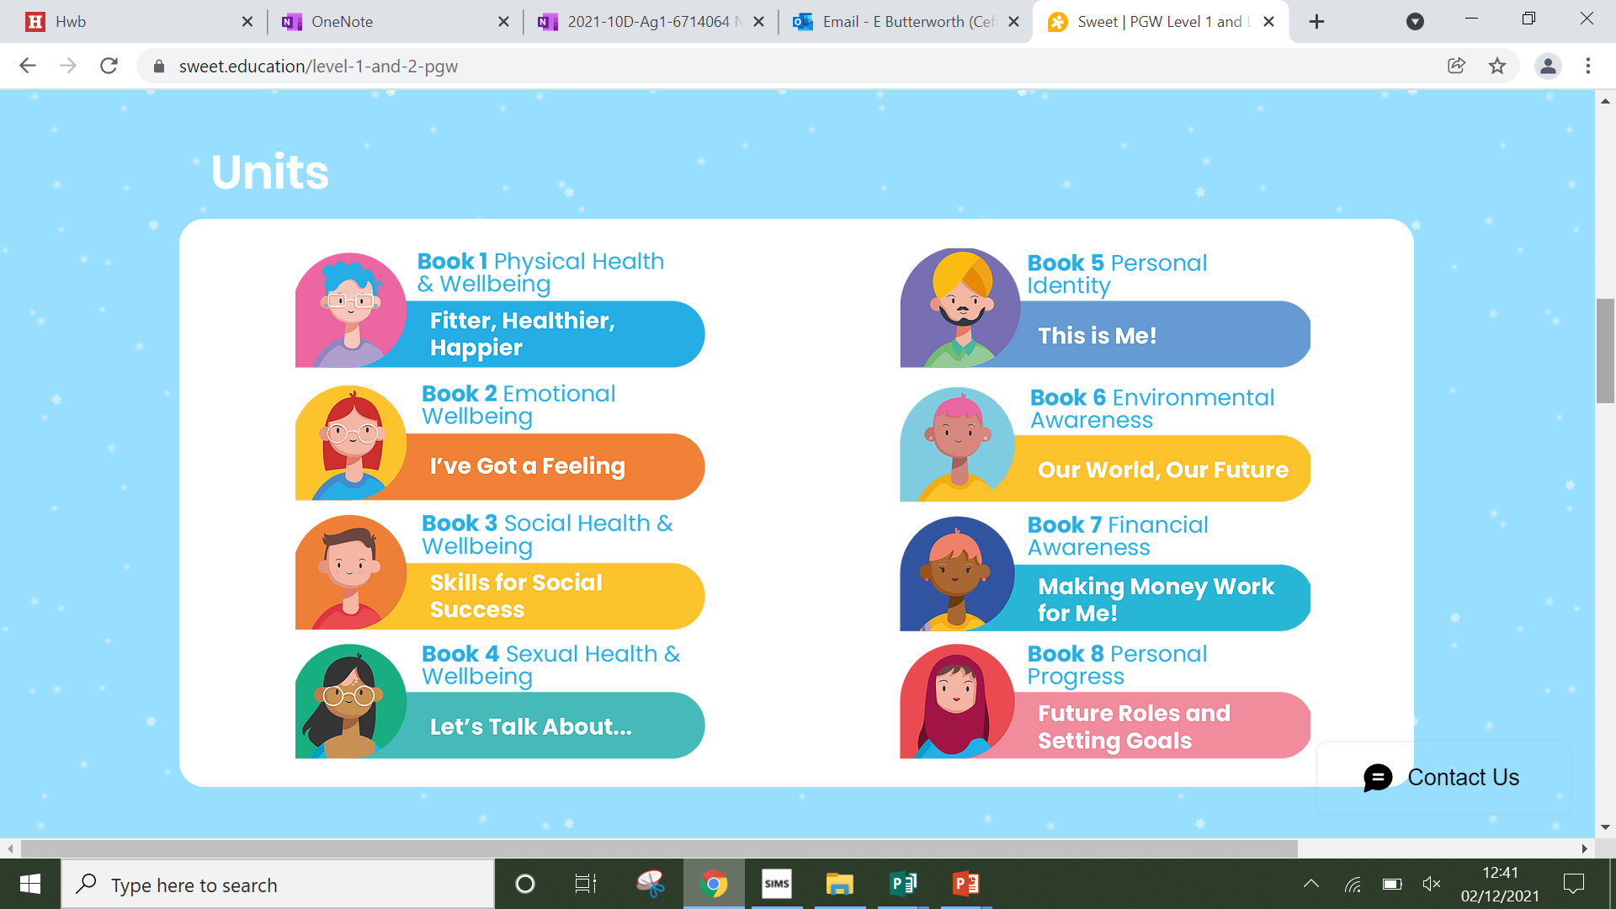
Content
Exam
Staff
Careers
Pupil view
Video
As part of the course you will explore the following units:

Slide 3
Content
Exam
Staff
Careers
Pupil view
Video
Sweet teaches valuable skills to help students lead happier, healthier and more successful lives.
The intention of this course is to provide life skills which can then be applied in adulthood.
Learners gain valuable skills in wellbeing, confidence and resilience.

Slide 4
Exam
There is no exam in this subject.
Pupils progress through challenges, collecting evidence of achievements in a portfolio. This portfolio provides the basis for the internal assessment & certification.

Slide 5
Exam
Learners will aim to achieve a Level 1 Award in Year 10 and progress on to the Certificate in Year 11.
Level 1 Award is equivalent to half a D Grade GCSE. *To achieve a Level 1 Award learners need to complete two of the units.
Level 1 Certificate is equivalent to a full D Grade GCSE. *To achieve a Level 1 Certificate learners need to complete four of the units.

Slide 6
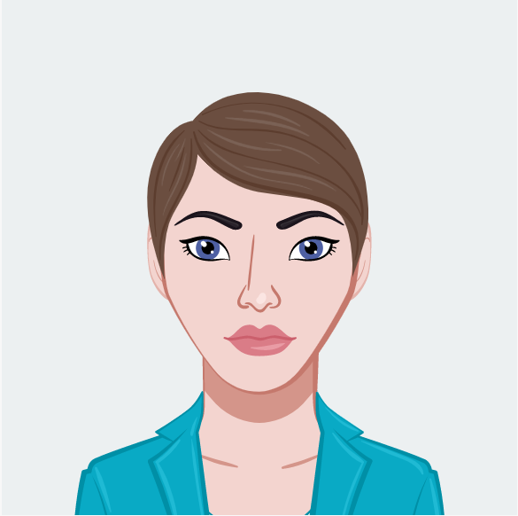
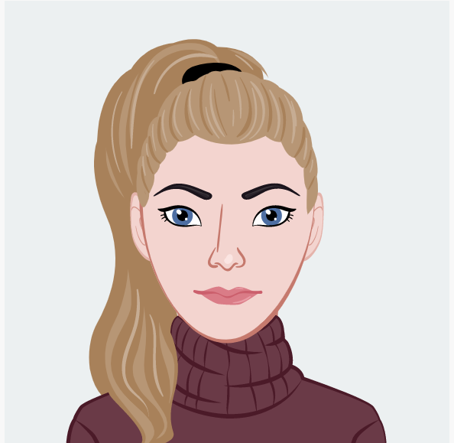
Staff
The teachers of this subject are:
* Mrs Chilcott * Miss Butterworth

Slide 7
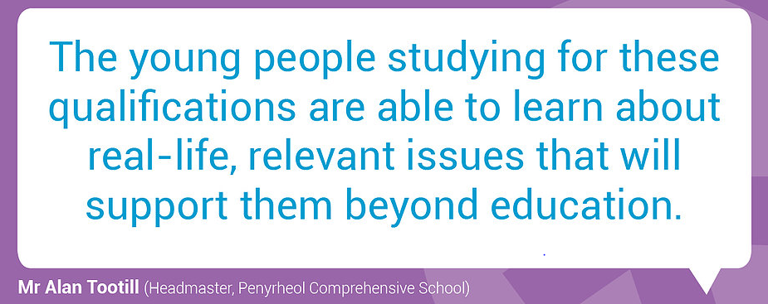
Careers
The life skills and knowledge gained can be applied in adulthood and for all career prospects.

Slide 8
Pupil views
‘Very enjoyable and can help you with life skills for the future’- Andrew
‘You get to talk about your own personal life and difficulties, It makes you feel comfortable that everyone in the class understands’- Katelynne.
’I like that you have class discussions about the work rather than just writing’-Shahad

