Slide 1
GCSE Level 1/2 Vocational Award Sport and Coaching Principles
WJEC ENTRY LEVEL FRAMEWORK SPECIFICATION

Slide 2
Content
Exam
Staff
Careers
Pupil view
Video
The Vocational Award in Sport and Coaching Principles has been designed to support learners in schools who want to learn about this vocational sector and the potential it can offer them for their careers or further study.
There are 3 Units of work:
Unit 1: Fitness for Sport – External exam
Unit 2: Improving Sport Performance – Internal exam
Unit 3: Coaching Principles – Internal exam

Slide 3
Content
Exam
Staff
Careers
Pupil view
Video
Unit 1:
Unit 1 introduces learners to the adaptations that take place in the body following exercise, how training can lead to improvements in fitness, and the planning of training programmes. The aim of this unit is to develop the knowledge, understanding and skills needed to plan training programmes to improve the fitness of individuals.

Slide 4
Content
Exam
Staff
Careers
Pupil view
Video
Unit 2:
Unit 2 introduces learners to how different areas of sporting performance can be improved. The aim of this unit is to provide learners with the knowledge and understanding needed to be able to analyse sporting performance, identify strengths and weaknesses and plan for improvement.
Unit 3:
Unit 3 introduces learners to the principles involved in sports coaching. The aim of this unit is to provide learners with the appropriate knowledge and understanding to be able to plan, lead and evaluate a coaching session within a sporting activity.

Slide 5
Exam
Unit 1:
Fitness for Sport Written examination:
1 hour 20 minutes
40% of qualification
80 marks
Format: short and extended answer questions based around applied situations.
Learners will be required to use stimulus material to respond to questions.

Slide 6
Exam
Unit 2:
Improving Sporting Performance Controlled assessment:
Approximately 4 hours
25% of qualification
50 marks
An assignment brief, will be provided by WJEC which will include a scenario and several tasks, available from the WJEC secure website.

Slide 7
Exam
Unit 3:
Coaching Principles Controlled assessment:
Approximately 6 hours
35% of qualification
70 marks
An assignment brief, will be provided by WJEC which will include a scenario and several tasks, available from the WJEC secure website

Slide 8
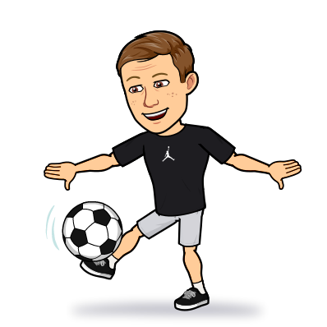
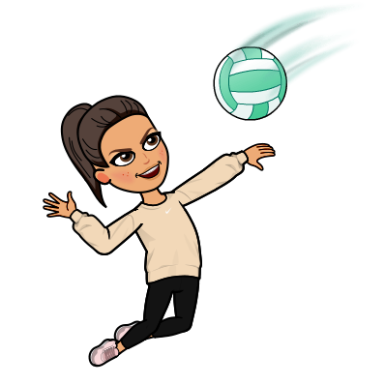
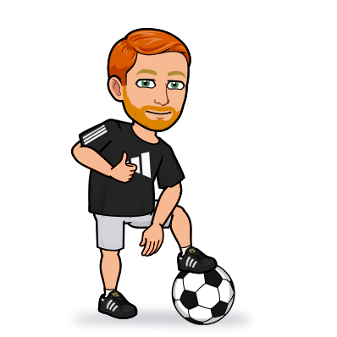
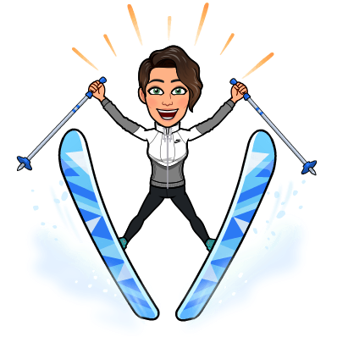
Staff
Mr Banfield
Miss Edwards
Mr Williams
Miss Rees-Morgan

Slide 9
Careers
How Sport Coaching will help you in the future
Sport Coaching will give you an understanding and appreciation of how to live a healthy lifestyle through the fitness for sport unit. It also educates you on the importance of living a healthy lifestyle.
Having the opportunity to coach a range of activities will enhance your ability to lead a group. The skills you will need to lead a session will include preparation via plans, organisation of time, people and equipment, time management as well as oracy skills. All these skills will be transferrable in to your future careers.
Future Careers
PE Teacher
Sport Development Officer
Sport Coach
Leisure Centre Manager
Professional sports person
Personal Trainer
Firefighter
Army
Police
Paramedic

Slide 10
Pupil views
“VIEWS OF CURRENT GCSE STUDENTS”
“Sport Coaching gives you an understanding on how to lead groups of people”
“Sport Coaching gives you the opportunity to work collaboratively or as an individual to try to improve a group of athletes”
“The Sport Coaching topics give you an understanding of the importance of living a healthy active lifestyle”
“Being given the responsibility to lead a group of pupils was something I had never done before. It gave me a lot of confidence the more I did it”.

