Slide 1
GCSE Music

Slide 2
Content
Exam
Staff
Careers
Pupil view
Video
In order to take Music at KS4, pupils must be able to play a musical instrument or sing to a good standard. You will also be expected to take part in at least one musical extra-curricular activity.
The GCSE course is based on skills learned at Key Stage 3. It contains a range of musical activities in which pupils show a keen interest, some of which are from the area of film scores and rock and pop music. Pupils are encouraged to perform both in and out of school in whatever musical style interests them.

Slide 3
Content
Exam
Staff
Careers
Pupil view
Video
There are four areas of study within the GCSE Music course:
1. Musical Forms and Devices
Forms and Devices are of fundamental importance in musical composition, and many of the common musical devices used by composers today have their origin in the Western Classical Tradition. Learners are encouraged to engage with a variety of music from the prescribed eras, through a range of performing, composing and appraising activities.
2. Music for Ensemble
Through a study of diverse musical styles composed for ensemble, such as Jazz and Blues, Musical Theatre, Chamber Music and Welsh Folk Music, learners will consider how music is composed for small groups of instruments and voices.

Slide 4
Content
Exam
Staff
Careers
Pupil view
Video
3. Film Music
Through this area of study learners are encouraged to consider how music for film is created, developed and performed, and the impact this has on the audience. Learners will have the opportunity to compose and perform film music and are encouraged to use musical technology to create mood and atmosphere through engaging with the story of the film.
4. Popular Music
Through this area of study learners are encouraged to explore the musical idioms associated with a variety of popular music, and they will have the opportunity to perform popular music as well as compose music associated with a popular music genre. Learners are also encouraged to use music technology, understanding the impact this has on the way music is developed and performed in popular music.

Slide 5
Exam
Unit 1: Performing (35%)
- Two performances; one as part of a group and the other a solo.
- Marked in school and externally moderated by the WJEC.
- A written task worth 5% based on one of the performed pieces.

Slide 6
Exam
Unit 2: Composing (35%)
- Compose two pieces; one in a style of their choice and the other to a brief set by the WJEC.
- A written task worth 5% based on an evaluation of the set brief composition

Slide 7
Exam
Unit 3: Appraising (30%)
- Written exam testing pupils' skill in interpreting what they hear.
- This is based on the four areas of study: 1. Musical Forms and Devices 2. Music for Ensemble 3. Film Music 4. Popular Music and the two set works as prescribed by the WJEC.

Slide 8
Staff
Mrs Evans and Mr Thomas are the subject specialists for Music.
All exam classes will be taught by both teachers.

Slide 9
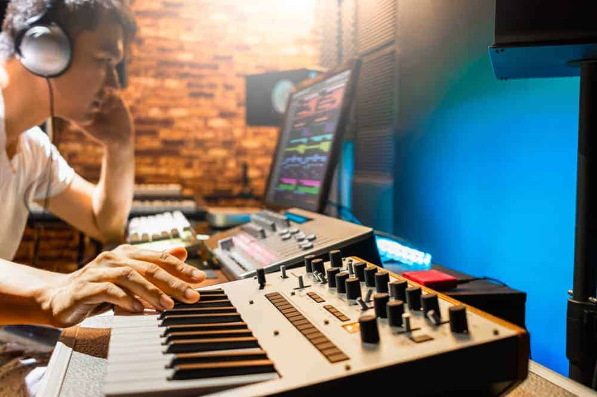
Careers
Performing
Musical Theatre
Backstage work (e.g. Sound Engineer)
Radio and TV
Teaching (classroom, peripatetic, private)
Composing (e.g. Film score/ Television)
Military Wind Bands (HM Forces)
Recording
Publishing
Distribution and retail
Agency and PR work
Music journalism
Management and marketing
Instrument making and repair.

Slide 10
Pupil views
“Taking Music for GCSE is an excellent way to improve confidence and helps you find your own specialism. The teachers are extremely encouraging, supportive and helpful in our journey through GCSE.” Beth Lewis, Year 11.
“Music lessons calm me down as well as build my confidence and let me believe in my own abilities. It’s a good atmosphere with kind and understanding teachers.” Jennifer Harvey, Year 10.
“In Music, we learn a lot of different techniques. We recently took part in a workshop where we wrote our own songs and learnt how to develop and record them using music technology.” Cai Preston, Year 10.
“GCSE Music is a fun way to express myself with the support of teachers. I enjoy being in music lessons because I feel that I can perform in a comfortable environment.” Rhianna Thompson, Year 10.
“Music helps build confidence. The GCSE is a good way to express yourself. The teachers are very supportive.” Rebecca Hails, Year 10.

Slide 11
Video
Here is footage that demonstrates the standard of performance that can be achieved in Music:
https://www.youtube.com/watch?v=NBMINoYKo28&ab_channel=GarethThomas

