Slide 1
History
Entry Pathways Humanities No Exam

Slide 2
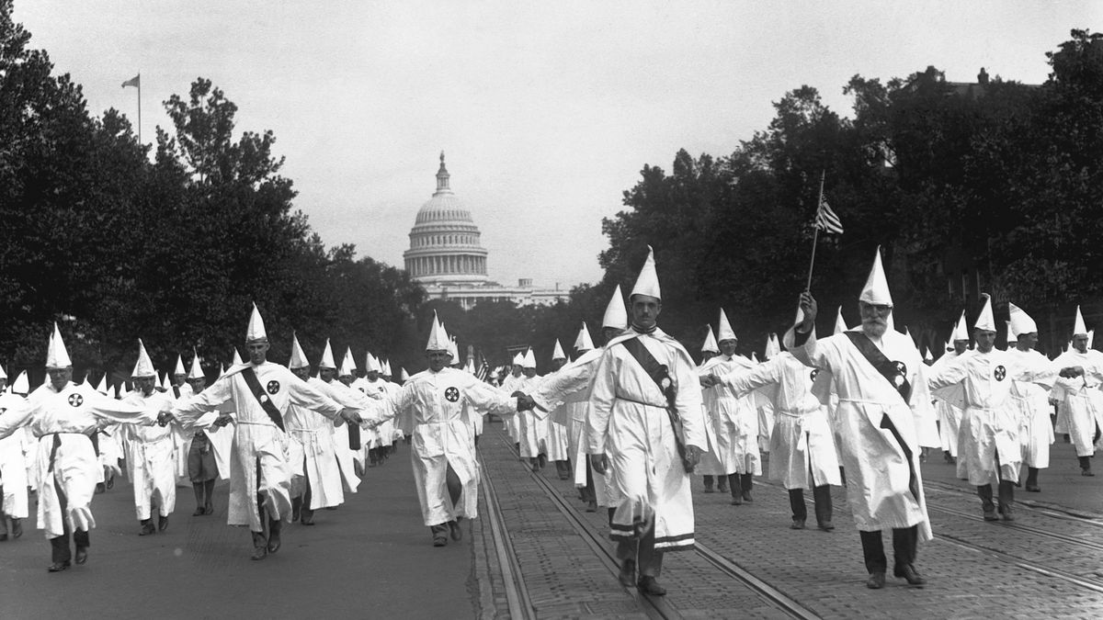
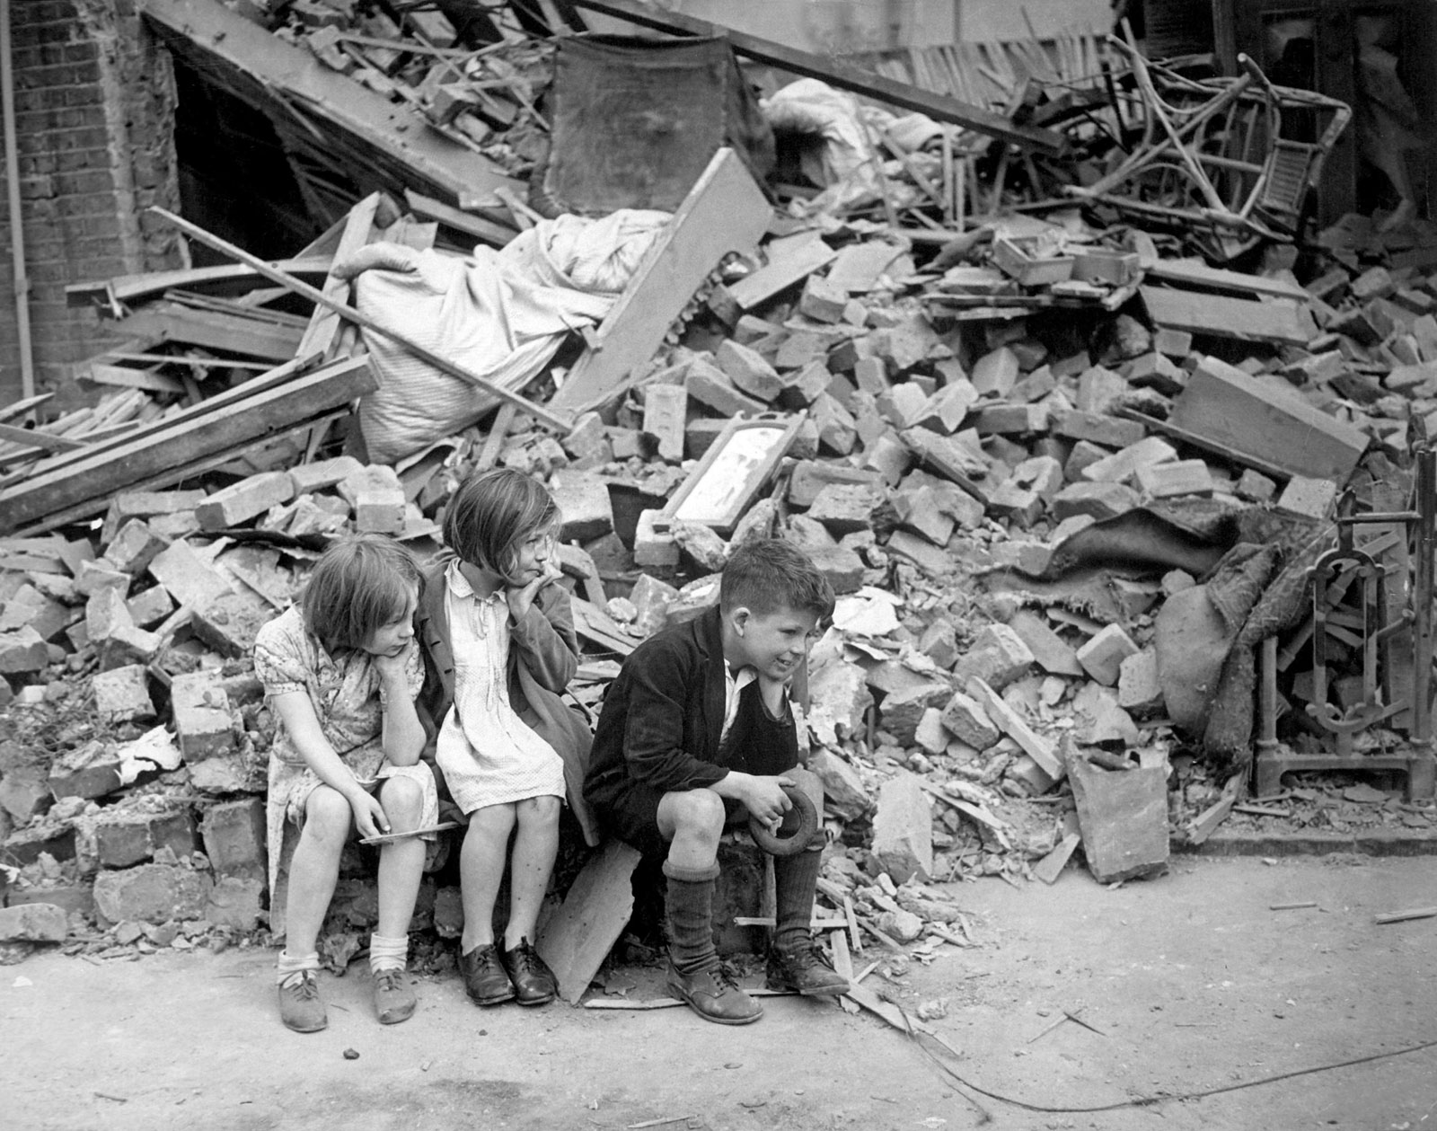

Slide 3
Content
Exam
Staff
Careers
Pupil view
Video
Entry Pathways Humanities (History) provides pupils with an inclusive and flexible qualification. Pupils work towards achieving credits, which are achieved through continual assessment in class-based tasks (no exams).
This option is good for those who enjoy studying History but find exams challenging.

Slide 4
Content
Exam
Staff
Careers
Pupil view
Video
Units Studied:
Britain and the Second World War 1939-1945: Evacuation and rationing, Coping with the Blitz, The role of women during the war, Keeping up morale – radio, cinema, posters, role of Churchill. 4 credits
Germany 1929-1939: Reasons for the Nazi rise to power, the key features of Nazi dictatorship including; propaganda and censorship, Changing life in Nazi Germany: work, women, young people, Jews, Why Germany took over other areas up to 1939. 4 credits
People and Protest: Why people decide to protest, protest methods used by protestors, Know about the results of protests. We focus on examples from recent times such as Black Lives Matter and from the past such as the Civil Rights Movement. 3 credits
Looking at local History: Using historical sources to find out about a local development. 3 credits

Slide 5
Exam
There is no exam with this qualification.
Pupils work towards achieving credits, which are achieved through continual assessment in
class-based tasks.
Pupils work towards gaining 14 credits = Certificate in Humanities Entry Pathways.

Slide 6
Staff
All GCSE classes are taught by subject specialists. Entry Pathways Humanities will either be taught by;
Mrs L. Williams, Head of History
Or
Miss S. Roberts, Teacher of History and School Council Lead

Slide 7
Careers
Entry pathways in Humanities is not suitable for A Level. Alternative paths are;
National Vocational Qualification (NVQ)
BTEC
Apprenticeships
The subject suits careers in;
Police
Education – Support Assisstant
Tourism

Slide 8
Pupil views

Slide 9
Video
Please copy and paste the link below into a web browser
https://web.microsoftstream.com/video/fbad0a64-79d7-452d-8809-be91cc8f067e

