Slide 1
GCSE Drama

Slide 2
Content
Exam
Staff
Careers
Pupil view
Video
The WJEC GCSE in Drama is an exciting, inspiring and practical course. The course promotes involvement in and enjoyment of drama, as performers and/or designers. Additionally it provides opportunities to attend live theatre performances and to develop skills as informed and thoughtful audience members.
Learners will be given opportunities to participate in and interpret their own and others’ drama. Learners have the option to work practically as performers and/or designers in units 1 and 2.
Learners will investigate a practitioner or genre of drama, work collaboratively to develop ideas to communicate meaning and experiment with dramatic forms and techniques to produce and realise a piece of original theatre. They will also have the opportunity to participate in the performance of an extract from a published performance text. Learners will demonstrate their knowledge and understanding of drama, including their ability to interpret texts for performance, in a written examination. However, in preparation for this assessment, learners are encouraged to study their chosen text practically as a performer, designer and director.

Slide 3
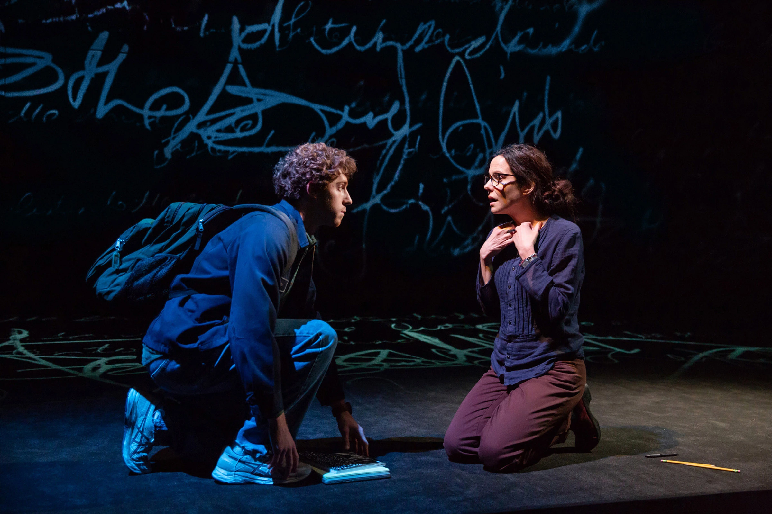
Content
Exam
Staff
Careers
Pupil view
Video
In units 1 and 2, learners are given the opportunity to develop acting and/or design skills as appropriate to their interests and facilities available in the centre. Learners must choose from the following:
- Performing - Lighting Design/ Sound Design
- Set Design (including props) - Costume Design (including hair and make-up)

Slide 4
Exam
Unit 1:Devising Theatre (40%)
Non-exam assessment
Internally assessed and externally moderated
Learners will participate in the creation, development and performance of a piece of devised theatre based on either the work of a theatre practitioner or a genre in response to a stimulus set by WJEC.
Written evaluation of the performance under formal supervision.
Assessed on either acting or design.
Learners will work in groups of between two and five performers.

Slide 5
Exam
Unit 2:Performing Theatre (20%)
Non-exam assessment
Externally assessed by a visiting examiner
Learners will participate in a performance based on two 10 minute extracts from a performance text of their own choice.
Learners will be assessed on either acting or design.
Learners work in groups of between two and four performers.

Slide 6
Exam
Unit 3: Interpreting Theatre (40%)
Written examination: 1 hour 30 minutes
Section A: Set Text
A series of questions on one set text explored as an actor, designer and director.
Section B: Live Theatre Review
One question, from a choice of two, requiring analysis and evaluation of one live theatre production seen during the course.

Slide 7
Staff
Mr Thomas is the subject specialist for Drama.

Slide 8
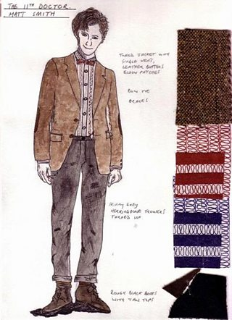
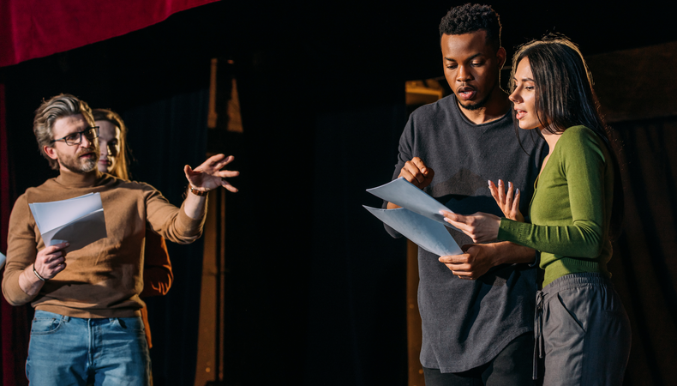
Careers
Actor
Broadcast presenter
Community arts worker
Dramatherapist
Runner, broadcasting/film/video
Theatre director
Theatre stage manager
Arts administrator
Choreographer
Teacher
Theatre technician
Talent agent
Theatre manager
Playwright/ Screenwriter
TV/ Film Production
Production designer- hair/ make-up/ set/ costume etc

Slide 9
Pupil views
“I’ve always loved Drama. By taking it for GCSE I always feel supported and it has helped me to gain confidence and make so many new friends. It is so enjoyable and I would recommend it to anyone.”
Eve Morris, Year 10
“I like Drama because it improves confidence a lot, it’s very fun, and it is amazing if you do or don’t enjoy theatre. There are opportunities in acting as well as production and staging elements.”
Seren Manley, Year 10
“Drama is such an essential skill in life. It encourages you to build confidence and memory skills, as well as giving you a wide variety of roles and plays to explore. It gives you important people skills that you will need in any job or interview.”
Daniel Collins, Year 11
“Drama is a great subject that has taught me to be confident. I really enjoy the atmosphere and it helps me to clear my mind.”
Maya Jenkins, Year 10
“Drama is the lesson I always look forward to. It allows me to express myself in different ways and be imaginative. It is enjoyable and educational at the same time, and the teachers give you the passion needed to be your best self.
Carla Nemes, Year 10

Slide 10
Video
The Importance of Drama: Transferable Skills
https://www.youtube.com/watch?v=q3DGHtpuV28

