Slide 1
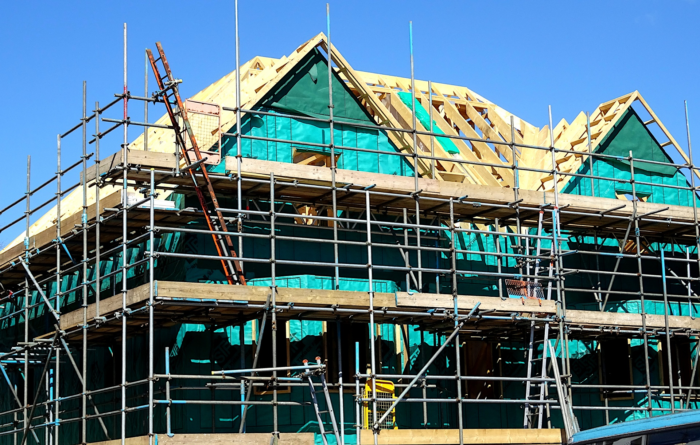
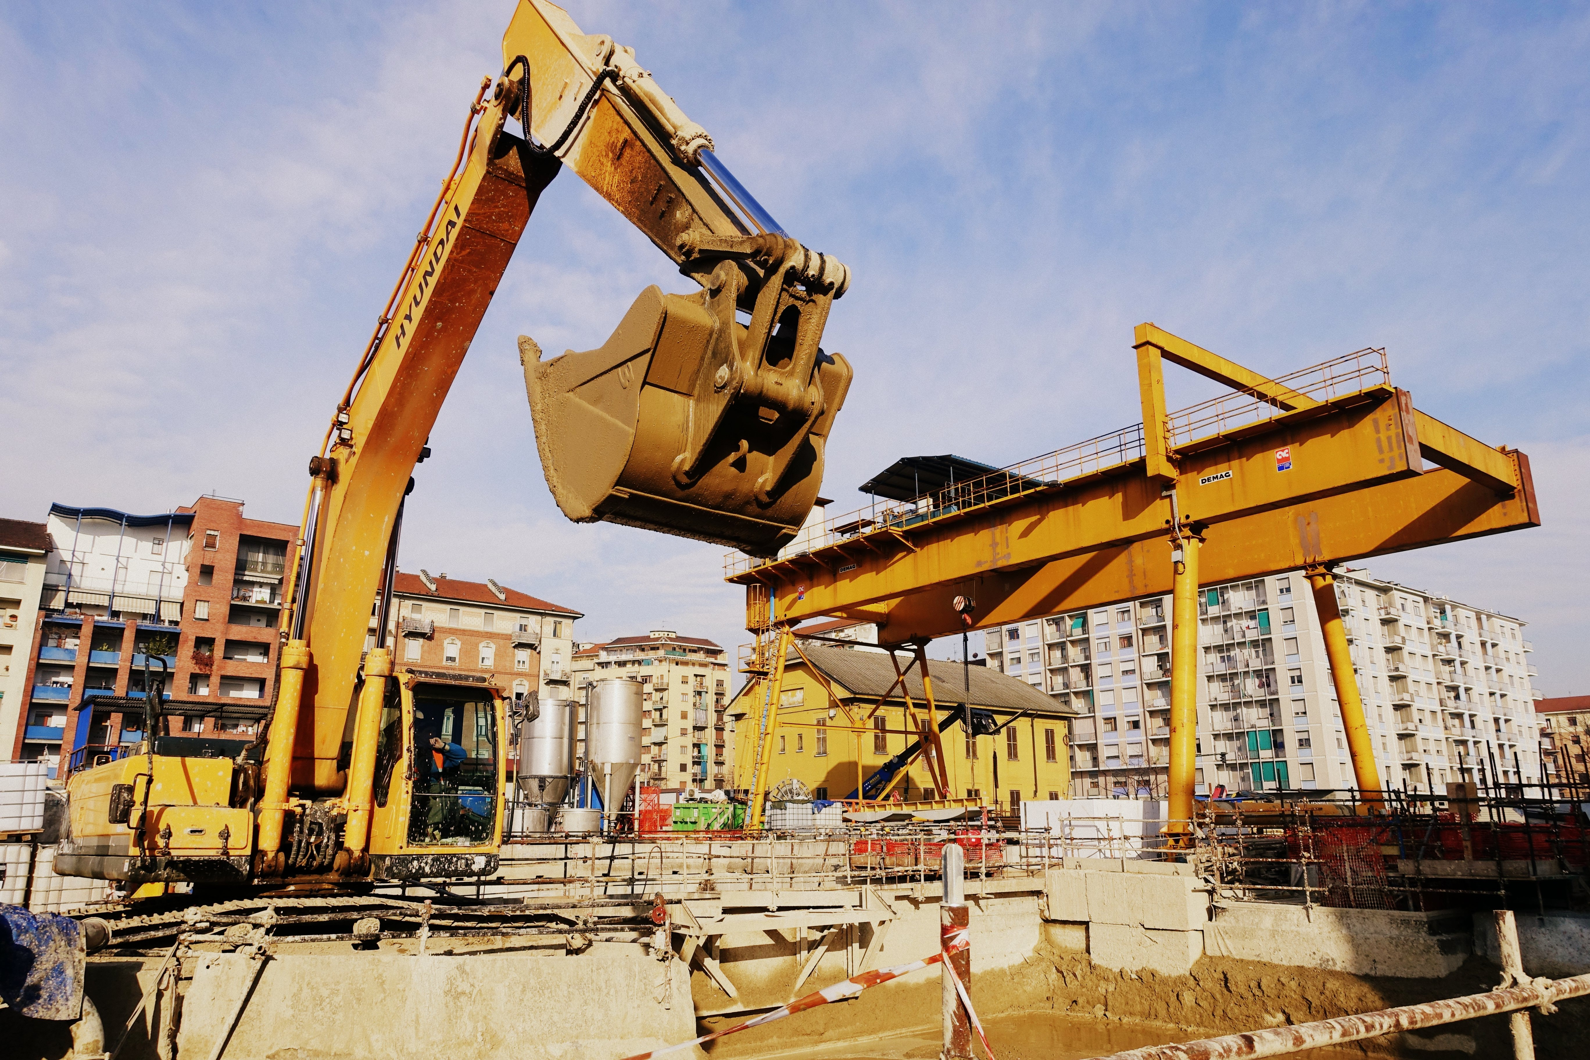
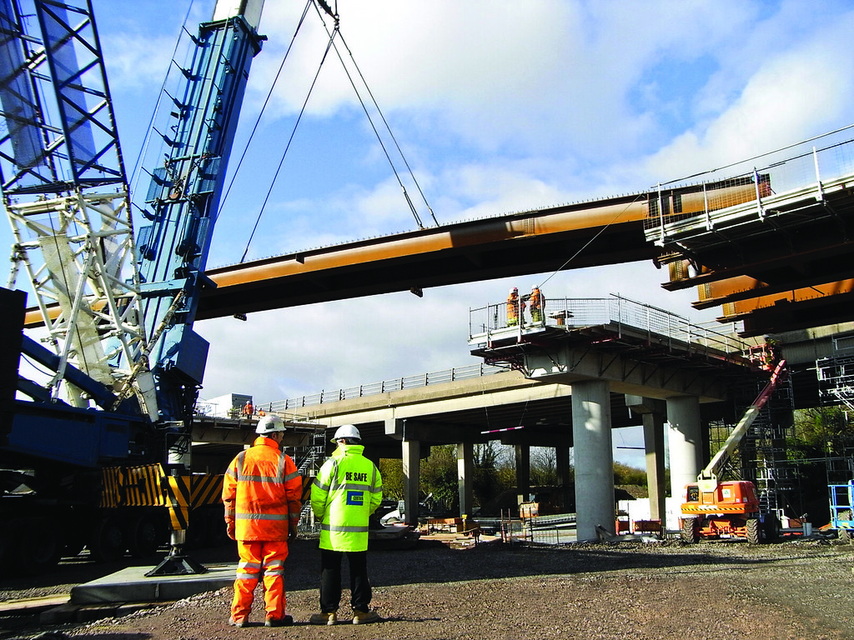
Level 1/2 Awards in Constructing the Built Environment.

Slide 2
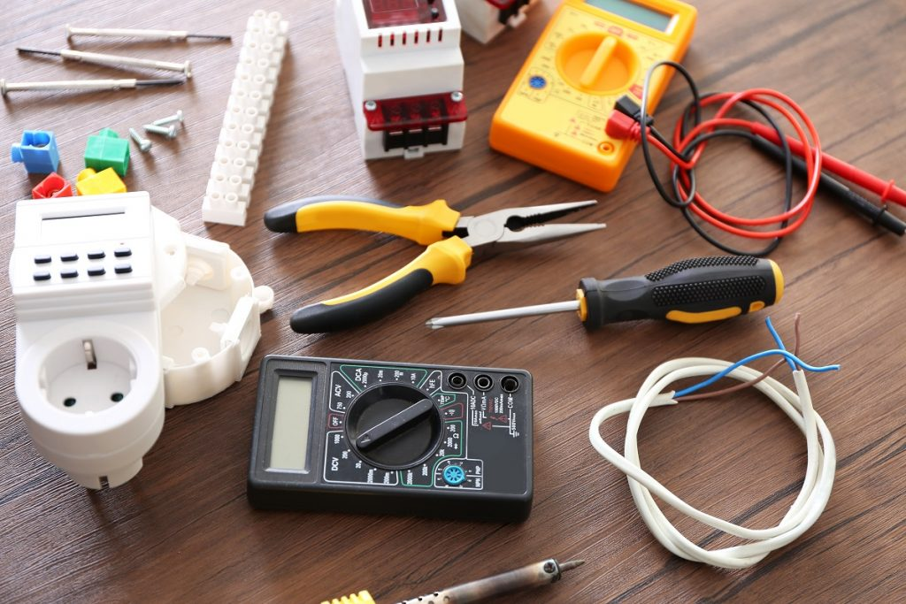
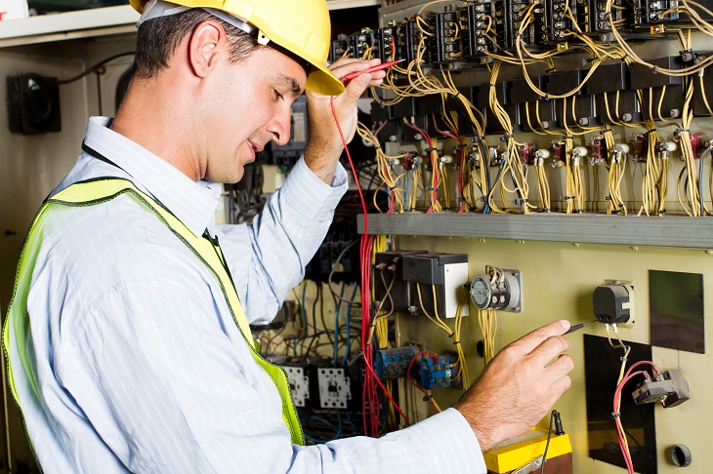
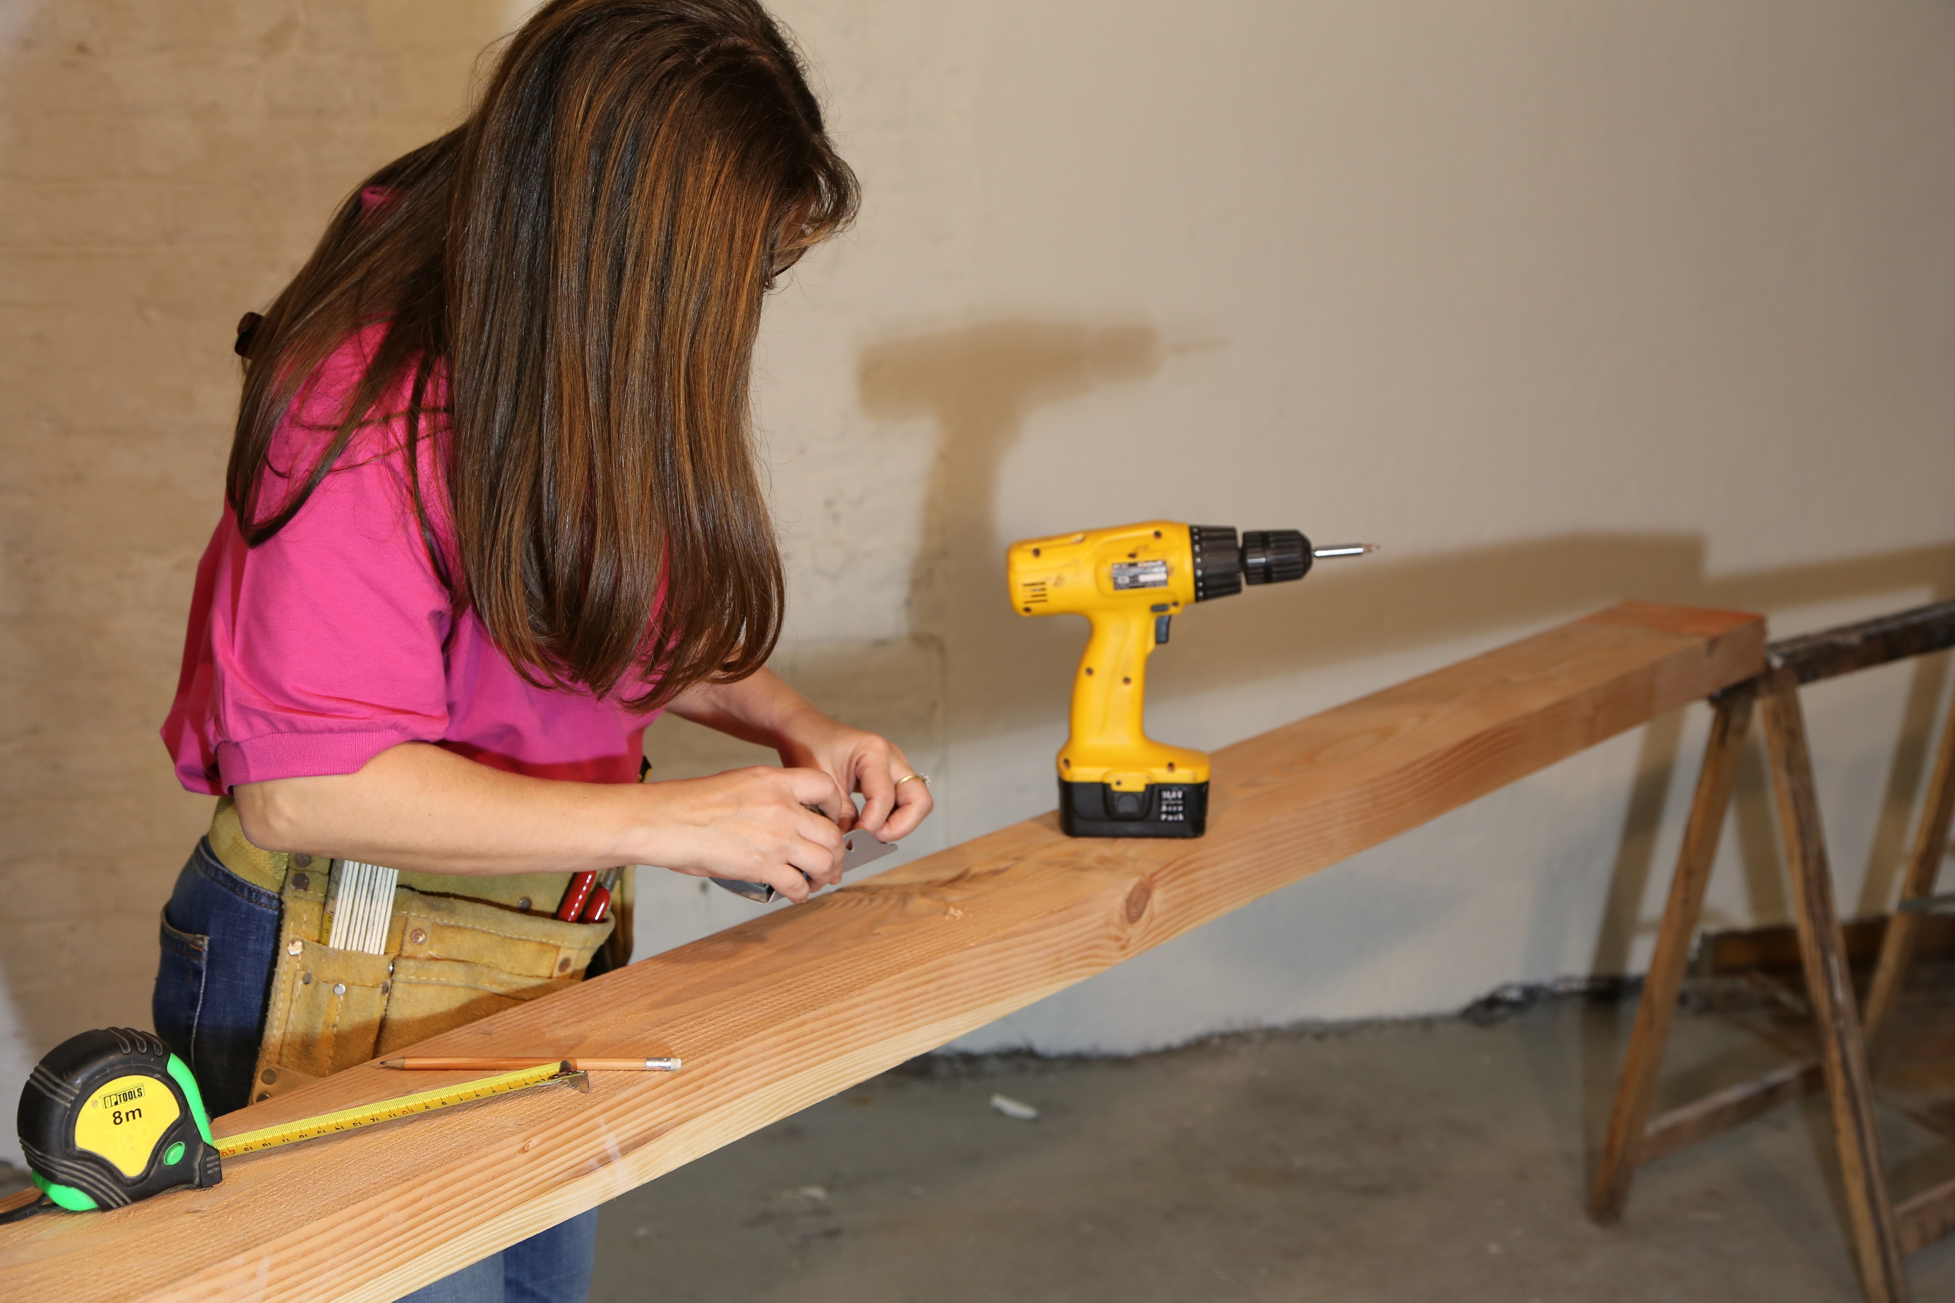
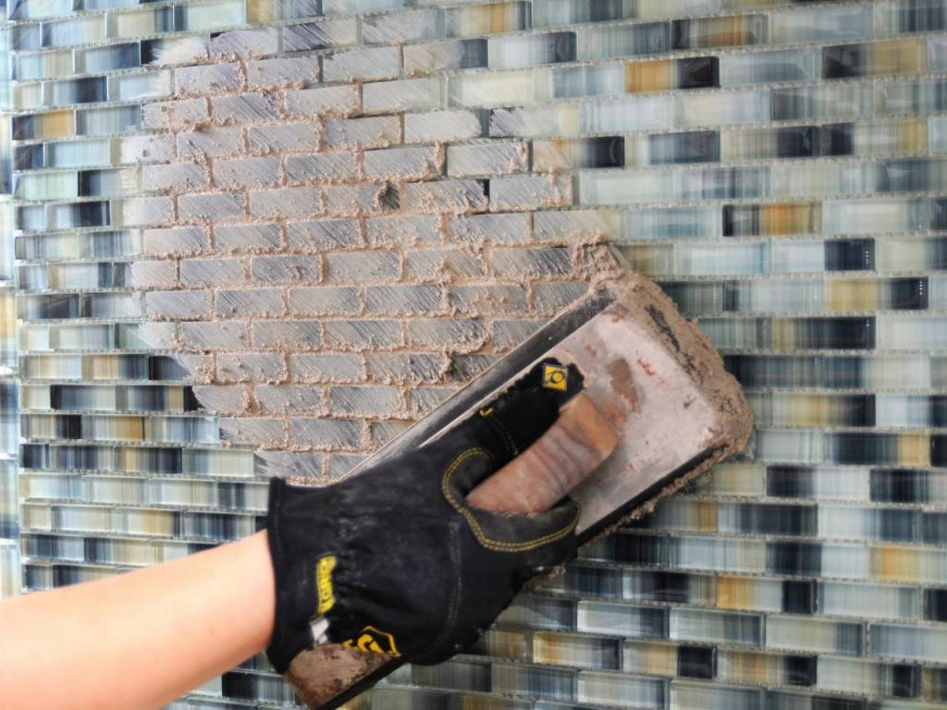
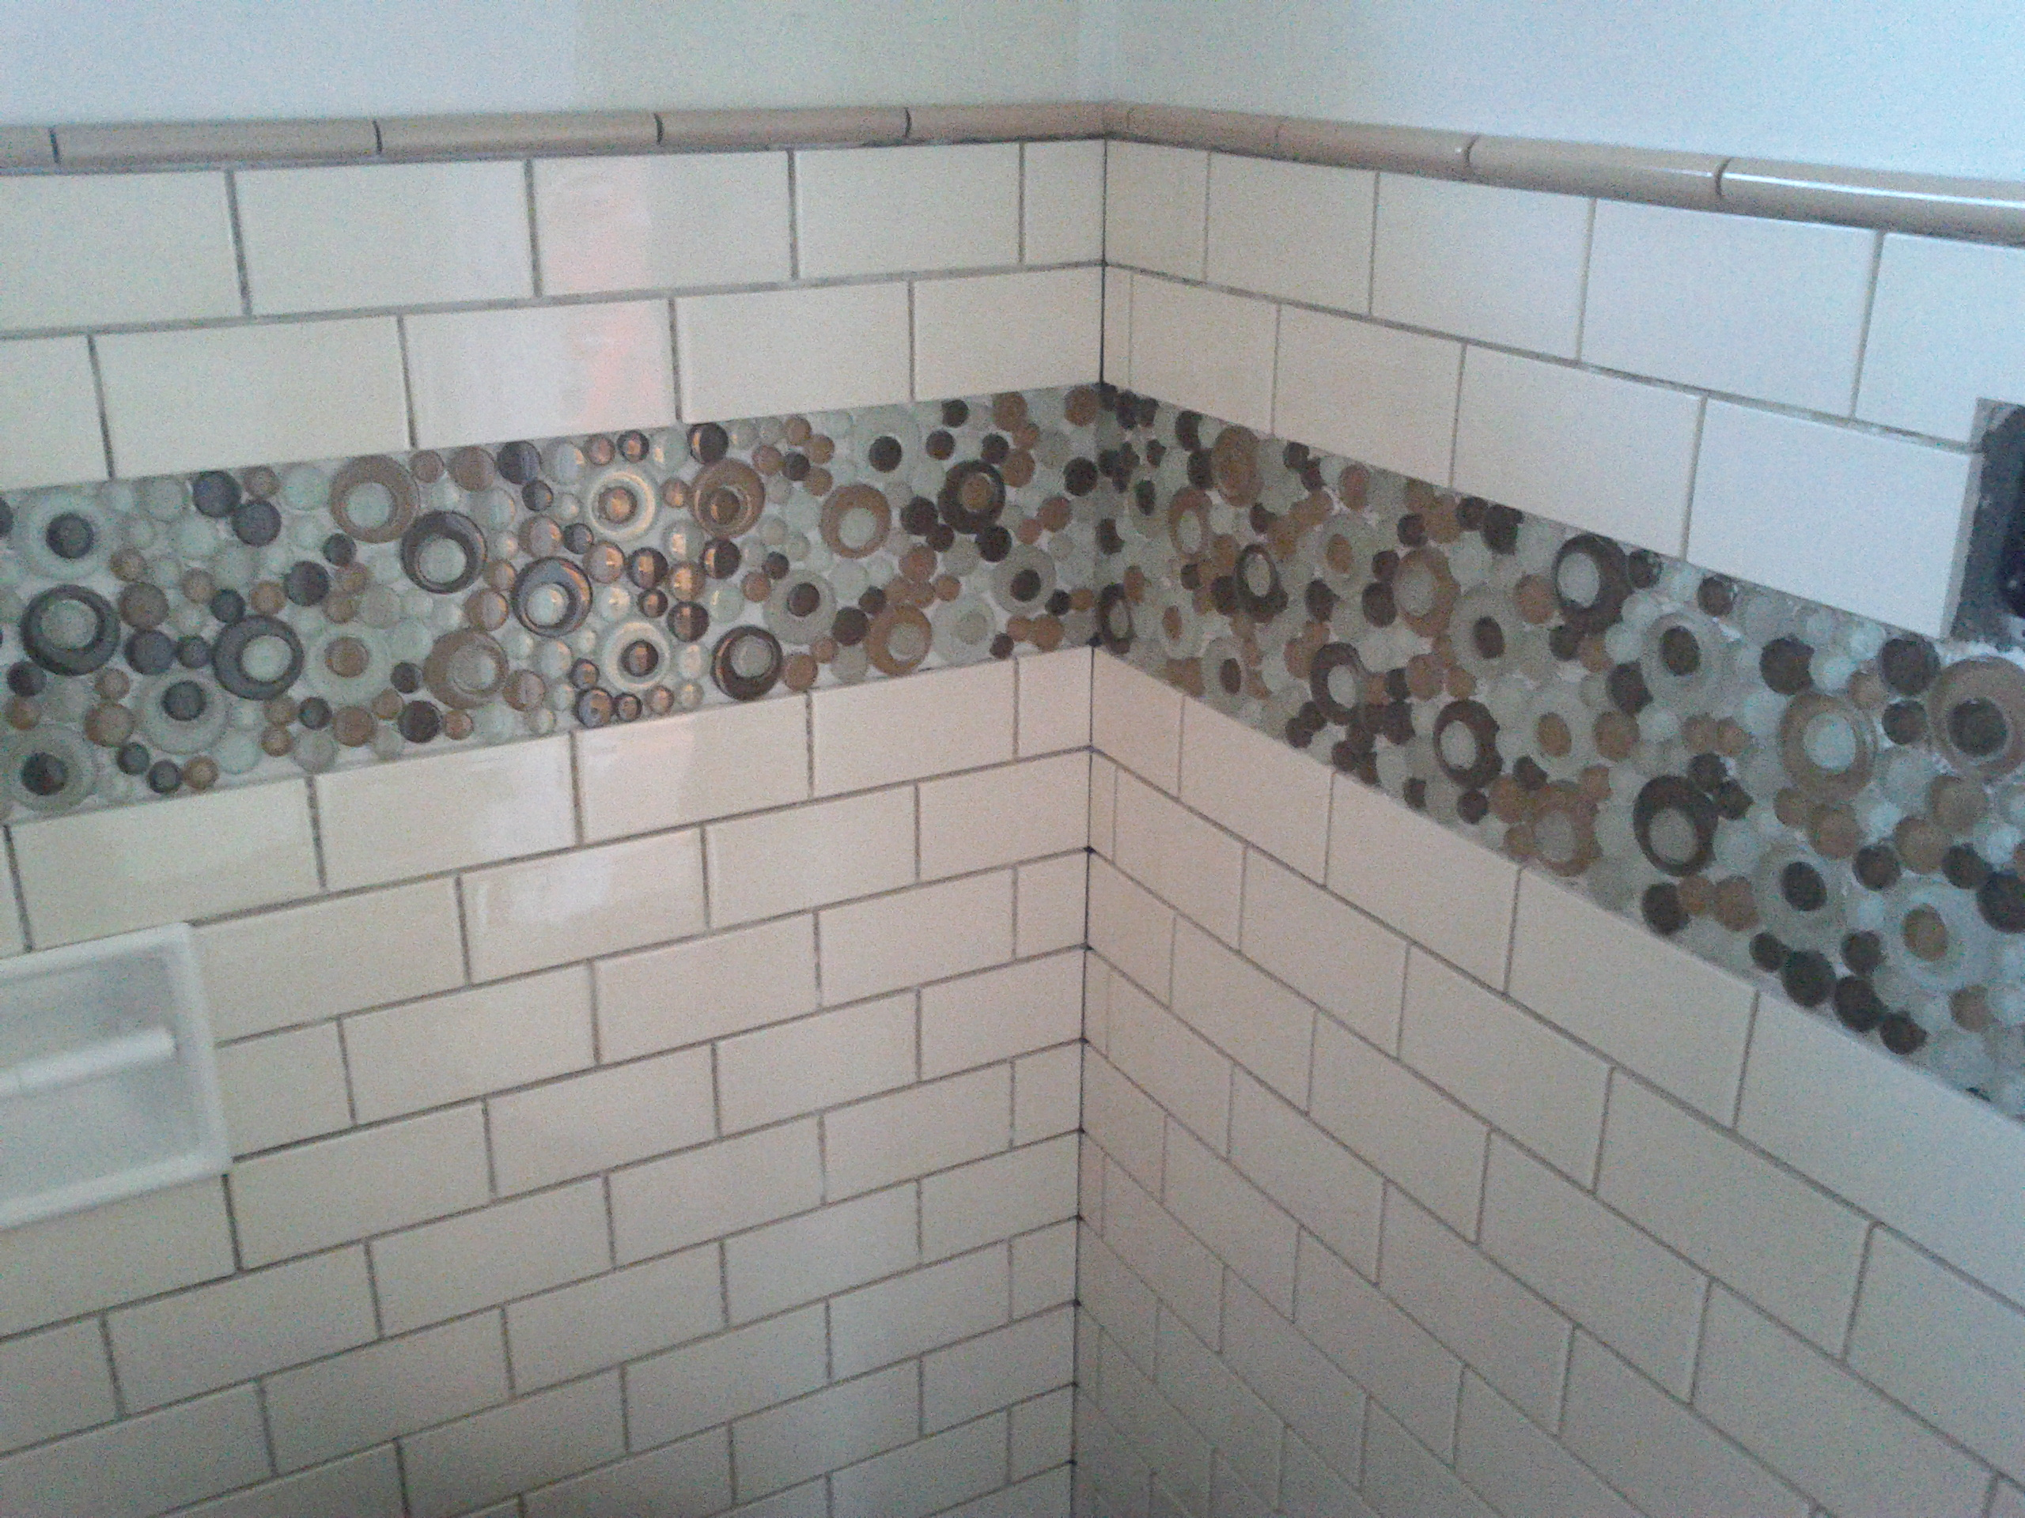
Content
Exam
Staff
Careers
Pupil view
Video
WJEC Level 1/2 Awards in Constructing the Built Environment offer a learning experience that focuses learning for 14-19 year olds through applied learning, i.e. acquiring and applying knowledge, skills and understanding through purposeful tasks set in sector or subject contexts that have many of the characteristics of real work.
Pupils will progress thier:
1. independent learning and development
2. problems solving
3. project based research, development and presentation
4. team building skills and how to behave in a professional environment
5. practical skills in carpentry, decorating, tilling and electrical.
6.Learning to plan practical tasks, carry out activities and review their outcomes.
This Photo by Unknown author is licensed under CC BY.

Slide 3
Exam
Unit Number | Unit Title | Assessment | Course Weighting
9811 | Safety and Security in construction | External exam | 25%
9812 | Practical construction skills | Internal coursework | 50%
9813 | Planning construction projects | Internal coursework | 25%

Slide 4
Staff
Mr David and Mr Evans are the subject specialist for Construction. ​
​
All classes will be taught by either Mr David or Mr Evans.

Slide 5
Careers
Future Careers​
There are many careers that you can go into with Construction:
Architect
Brick Worker
Construction Managers
Carpenter
Engineer
Equipment Operator
Elevator Installer/Repairer
Electrician
Plumber
Project Manager
Roofer
Sheet Metal Worker
Safety Officer
Stone Mason

Slide 6
Pupil views
"I think Construction is a great course, because you learn about life skills, jobs, safety on site and you do lots of practical work".
"I really like using all the machine tools in the workshop and learning about different jobs in construction I could do".
" Construction is a really good course because of all the practical elements of the course, it's really fun using the hand tools and power tools".
I have enjoyed this course, because of all the time we spend in the workshop, learning about different carpentry skills, wall finishing and simple electrical tasks".

Slide 7
Video
https://www.youtube.com/watch?v=xTiqFF9MjLA

